Slide 1
Integration of a Multimodal Travel Demand Model with the EPA’s Emission Model and
Off-Road Vehicle Emission Guidance:
Lessons Learned
May 20, 2015
Scott A. Peterson and Drashti Joshi

Slide 2
Overview
Role of CTPS
Need for Integrated Model
Travel Demand Model (TDM)
Multi-modal Travel
Air Quality Models (AQM)
Linkages Between TDM and AQM
Lessons Learned

Slide 3
Role of CTPS
Support Staff to the Boston Region MPO
Have a group focused on model development
Have staff trained in air quality
Use model to support LRTP
Support MassDOT in project analysis

Slide 4


Need for an Integrated Model
Air Quality Conformity Analysis
Support MPO Goal to Reduce CO₂
Assist the MPO and MassDOT
in conducting Health Impact
Assessments
Support MassDOT Goals Outlined in the GWSA

Slide 5
MPO covers 101 municipalities, but the model area covers 164 municipalities, representing eastern MA

Slide 6
Travel Demand Model
Traditional 4-Step model is in use
Covers eastern Massachusetts
Covers 4 time periods
2727 transportation analysis zones (TAZs)
Five trip purposes
Multi-modal

Slide 7
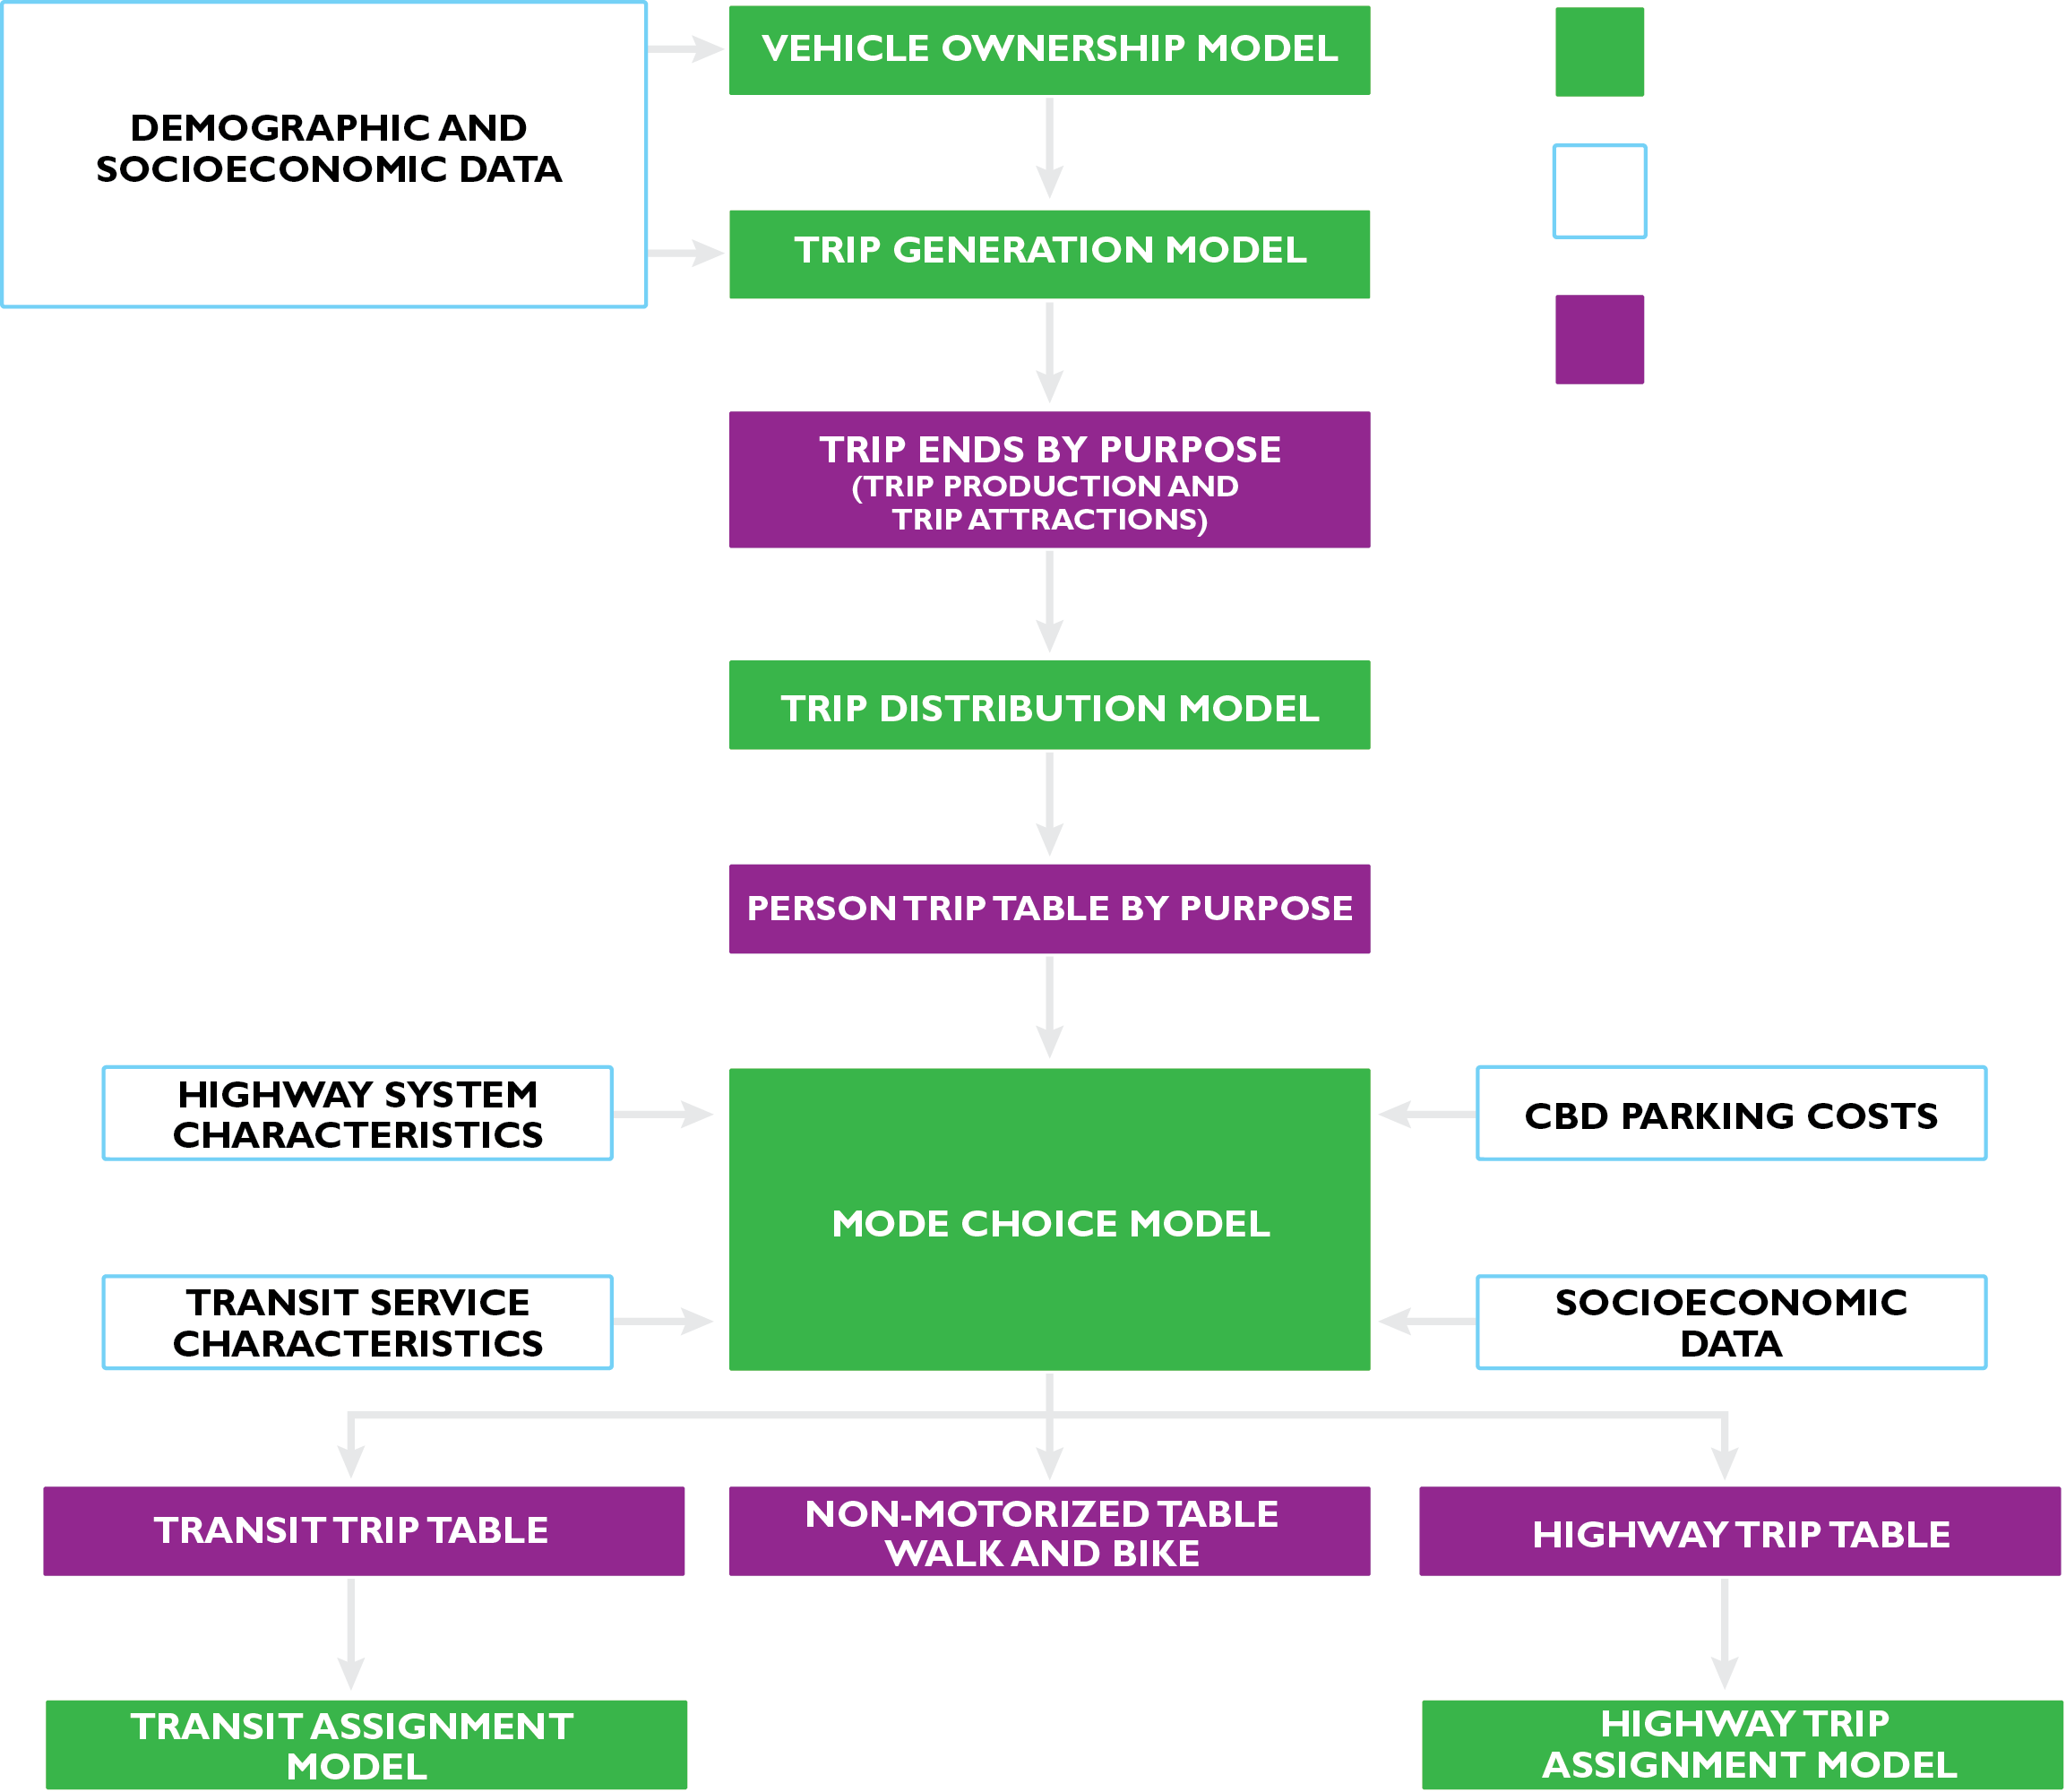
Travel Demand Model

Slide 8

Multi-modal Travel
Highway (10.5 million vehicle trips)
  Autos
  Trucks
Transit
  Buses (174 routes)
  RTL (9 routes)
  CR (14 routes)
  Ferry (3 routes)
Non-motorized
  Walking
  Biking

Slide 9
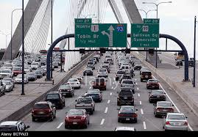
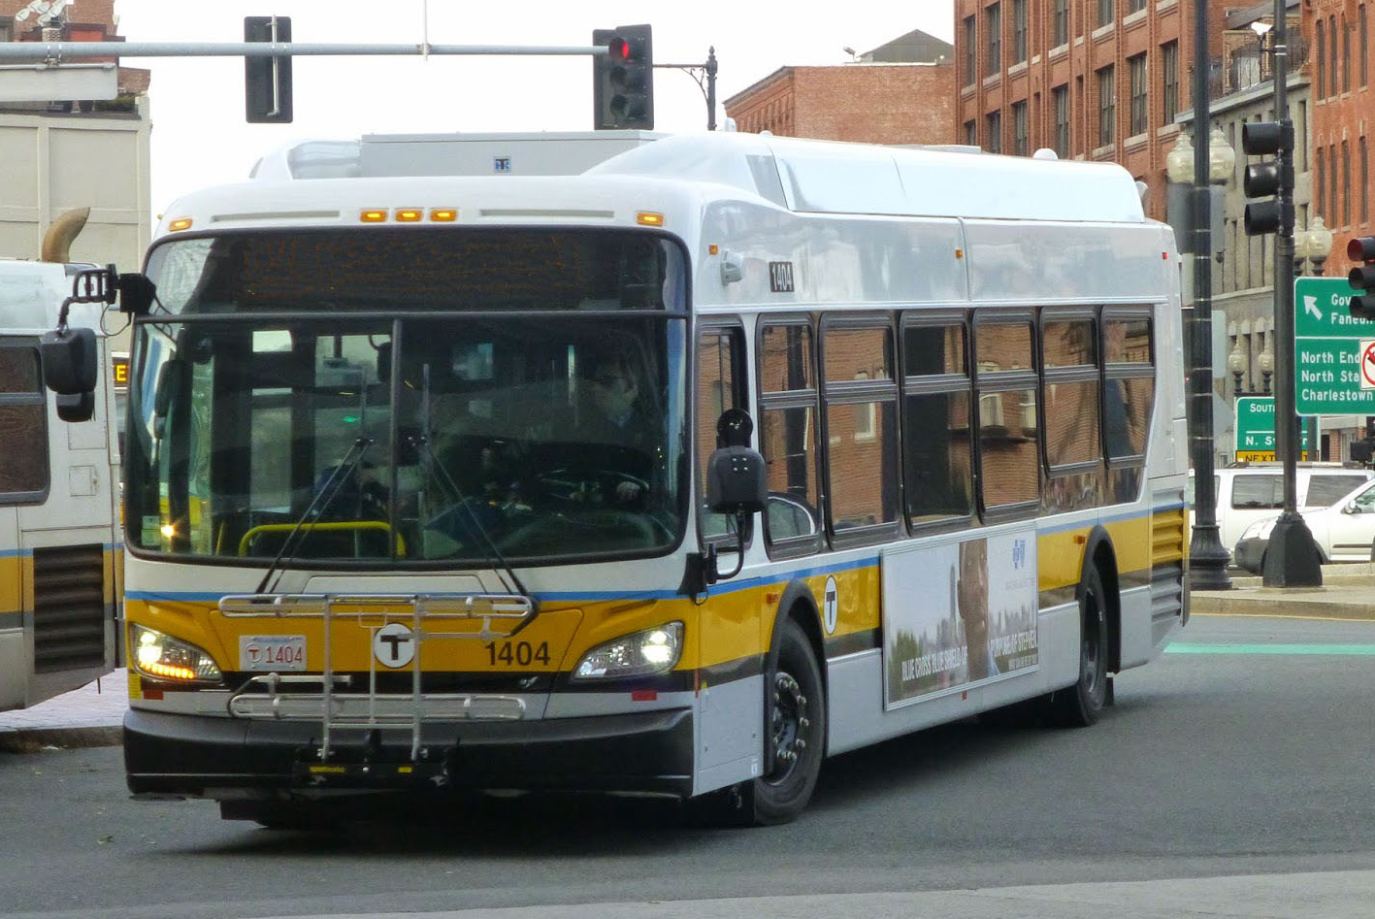
Air Quality Modeling
MOVES2014 Guidance for on-road vehicles
  Autos
  Trucks
FTA New Start Guidance for Buses
  Diesel buses
  CNG buses
  Electric buses
  Duel-mode buses
FTA/EPA Guidance on CR emissions
NESCAUM/EPA Scoping Report for Marine Vessels

Slide 10
Linkages
Utilize detailed roadway network layer
Reflect off-road transportation modes as accurately as possible
Travel model calibrated to existing condition (volumes and speeds)
Develop customized inputs for MOVES2014

Slide 11
Linkages
On-road emissions
  Calculate and adjust inter-zonal assigned emissions using auto and truck volumes and speeds by geography
  Calculate intra-zonal auto and truck emissions using volumes and speeds
  Calculate cold-start auto and truck emissions
  Calculate bus emissions by fuel type

Slide 12
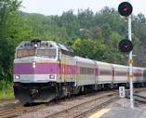
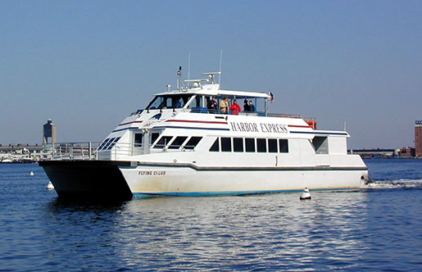
Linkages
Off-road emissions
  Calculate CR emissions
  Calculate ferry/water taxi
  emissions
Tally emissions
  On-road emissions
  Off-road emissions

Slide 13
Lessons Learned
Developing a detailed highway and transit network for assignment consistent with geographic areas being summarized
Truck assignment the most difficult to replicate
Develop flags to isolate each bus technology type and route
Need better data on marine engine types
Having data on fuel use is extremely helpful to estimate fuel economy for non-road vehicles

Slide 14
Thank You!
Contact info:
speterson@ctps.org

