Slide 1
Project Prioritization Tools for Efficient Planning Analysis
Amar Sarvepalli

Slide 2
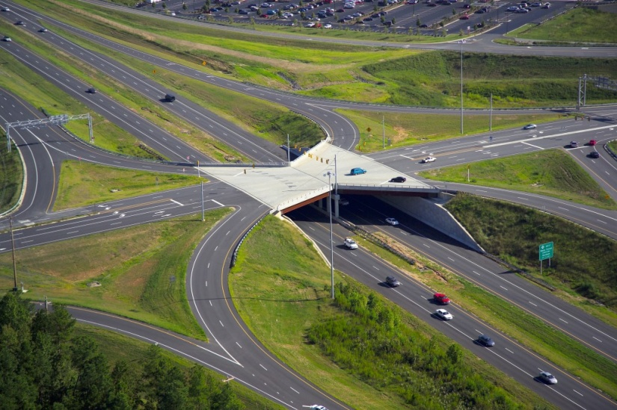
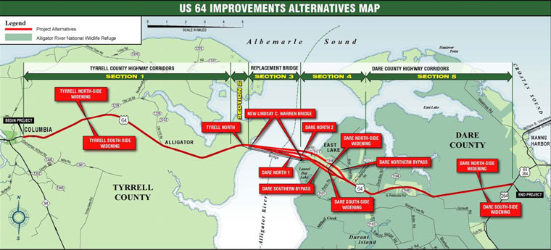
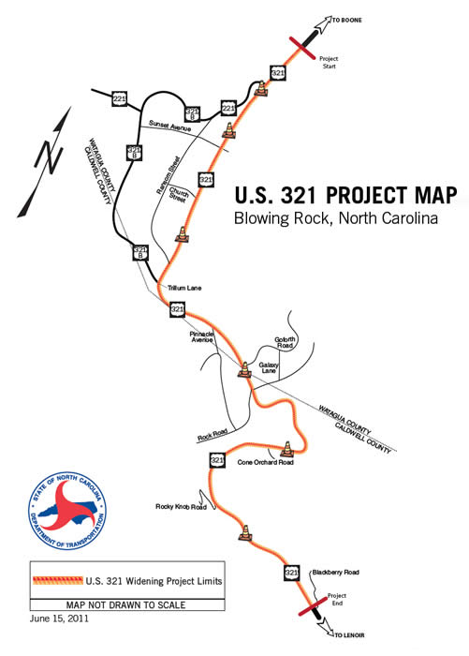
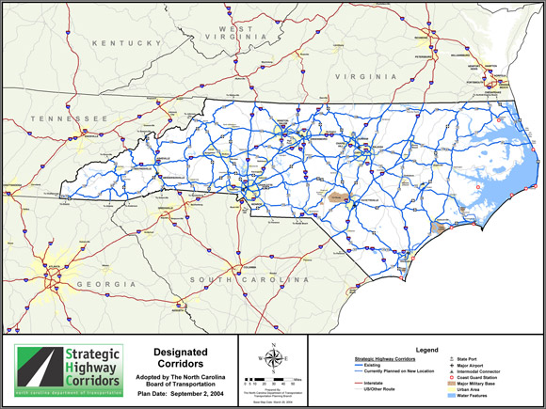
Need for tool ?
500 projects in 6-8 weeks
Need VMT, VHT and More
Notes:
The pain of MPO folks having to run projects through their model to get “project results” in order to evaluate the transportation plans is no fun.
How many of you have had to code these projects?? How many have had to run the model multiple times to evaluate the projects and give some ranking of them?
Not only is the coding of all of those projects a hard task but evaluating each one and getting VMT, VHT effects as well as assuring the model run worked and the results are reasonable. Of course we all know how EASY IT IS to look at the model output files to make sure things ran and the results seem to be reasonable for things like VMT, VHT etc
What happens when you get a directive that says “evaluate a list of 500 projects for funding priorities and we need them in less than two months!”
Well

Slide 3
50,000 Feet – Big Picture
Three Things to know
  Master Network : Code all the projects
    Ex: NCSTM is coded with all the projects from MPO LRTP, TIP, SPOT & RPO (~1000+ projects statewide)
  Project Evaluation Criteria (Client requirements):
    How we want to evaluate the benefits of the project?
    Region wide: VMT, VHT (by horizon years)
    Project Benefits: Speed, Flow (by horizon years)
  Travel Demand Model: What we do know about it?
    Statewide or Regional MPO
    How does it work? Order of the steps involved

Slide 4
Overview
Master Network
Statewide Model
Network Manager
Trip Generation
Skimming
Distribution
Mode Choice
Assignment
Non-Resident Models
Project Output
Inputs
Outputs
Run Status/Log File
Evaluation Stats
Map
Project List
Notes:
1) Tool to evaluate 600 – 800 Highway projects
2) Highway network manager tool
3) Wrapper around Statewide model
4) User choice on steps to be run
5) Automatically saves selected output for each run
6) Ability to run various post processing methods: travel time savings, accessibility, project trips, work trip benefits and other

Slide 5
Statewide Model
1) Full Run
Trip Generation
Less likely to vary by project
Need to run only once per horizon
Skimming
Varies by project
Distribution
Somwhat varies by project
Mode Choice
Depends on the TDM model & project
In the statewide model, mode chocie is less sensitive to small highway improvements
Assignment
Varies by project
Doesn't vary much by proejct
Non-Resident Models
2) Project Run
Network Manager
3) Network Manger
Project Manager
4) Project & Network Manager
Notes:
Full Model run: Update highway network with the project
2) Project run: To reduce runtime, run only the steps that vary by project
3) Network Manger: Update highway network with the project
4) Project & Network Manager:Update highway network with project and run specific steps

Slide 6
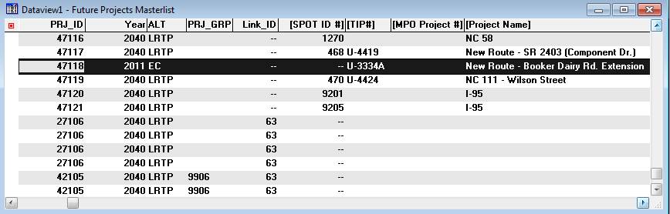
Project Manager
Project Manager: Runs single or multiple projects
PRJ_ID: One project at a time
LINK_ID: Only a specific link of a project
PRJ_ID & Link ID: One ore more projects but one of the project link has different attributes
YEAR: All existing & committed projects till that year (2010 or 2040)
ALT: By Alternative (ex: LRT or E+C or 2010 E+C & 2040 LRTP),
OTHER: any other combination of projects
Notes:
1) Ability to handle different project years
2) Ability to run different alternatives at one click (E+C or LRPT)
3) Ability to evaluate single projects or groups of projects
4) Ability to vary base network such as: Base, E+C or LRTP projects
5) User can run only selected steps (instead of entire model)

Slide 7
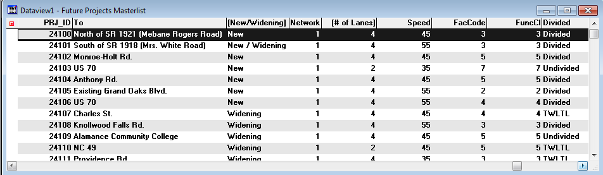
Network Manger
Updates the highway network attributes for each project based on PRJ_ID or LINK_ID:
Number of Lanes
Speed
Facility Type
Functional Class
Median Type
Terrain
Extracts and saves network
Notes:
Can be set to update any number of attributes.
Updates based on the PRJ_ID and LINK_ID coded in the master network
Extracts and saves a copy of the updated network for future reference / use

Slide 8
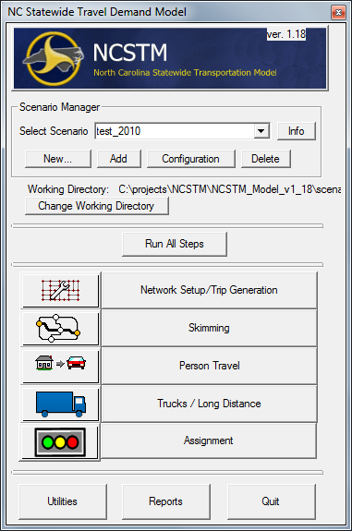
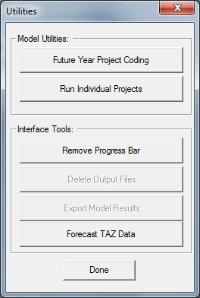
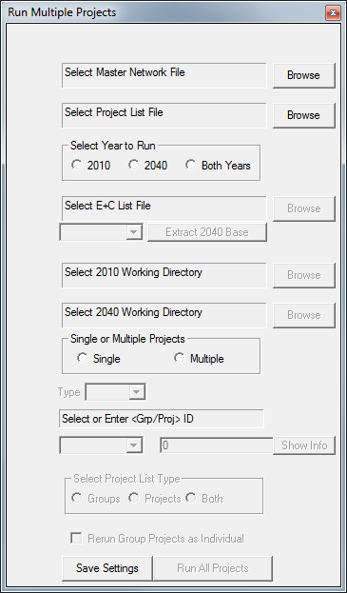
Toolbox GUI
1
2
3
Notes:
The second tool was a TransCAD tool to feed the project list into the model and allow the user to choose to evaluate an entire list of up to 200 individual projects or run a combination of projects(like E+C), or just one specific project.
I’m gonna hit the highlights and Amar will step you through interactively

Slide 9
Net Manager Tool (Tanscad)
Master Network
Project List
Browse or Build E+C List
Browse for 2010 Directory
Browse for 2040 Directory
Select “Group” or “Project”

Slide 10
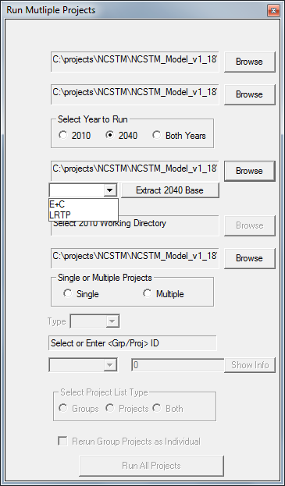
Select Year to Run > Base or Future Year
2040:
Enables to browse scenario directory for 2040
Enables to browse “E+C” Project List (.bin file)
Enables to select an ALT in the “E+C” project list.
Enables to extract the 2040 base network
A
B
C

Slide 11
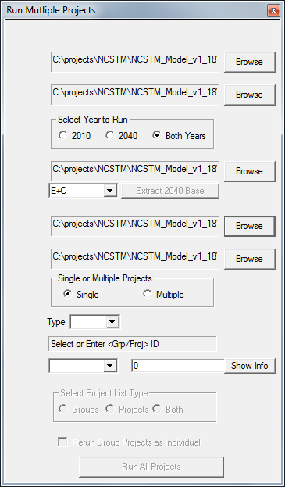
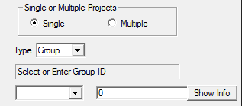

Single or Multiple Projects > Single
Enables the dropdown menu
Type:
Changes Enter <Grp/Proj> ID
Show Info: Displays info of the entered group /project

Slide 12
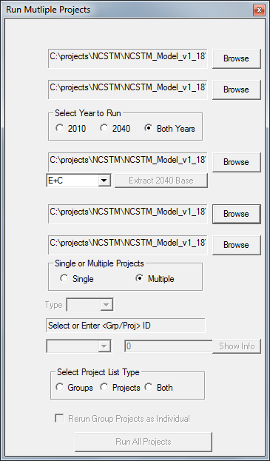
Single or Multiple Projects > Multiple
Enables to Select Project List Type
Groups:
Runs all groups of projects listed under “PRJ_GRP” field of Project List file.
Projects:
Runs all projects listed under “PRJ_ID” field of Project List file.
Both:
Runs both Groups and Projects.

Slide 13
User Settings
Assignment Module runs four time periods
Added congested skimming procedure for each alternative
Custom number of iterations and convergence criteria
Runs select link analysis for each project and time period
Logs runtime for each step
Automatically saves outputs by project name

Slide 14
Evaluation Criteria
Generation 1:
  Statewide VMT, VHT and network speed changes
  Volume to capacity (VOC) improvements
Generation 2:
  Direct and Indirect users, travel time savings & trip minutes gains
  Travel time improvement for the trips using the project (Direct)
  Value of time by vehicle class and dollars of savings per year over 10- 15 year horizon

Slide 15
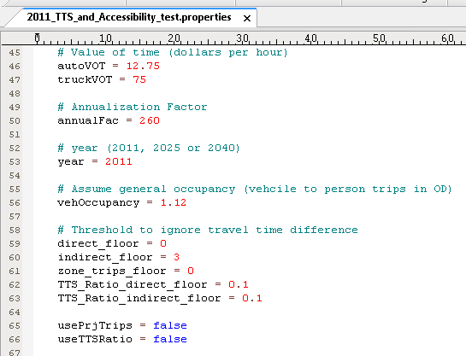
Custom Settings on Criteria
Users can specify various thresholds
Notes:
Not sure if I want this slide??

Slide 16
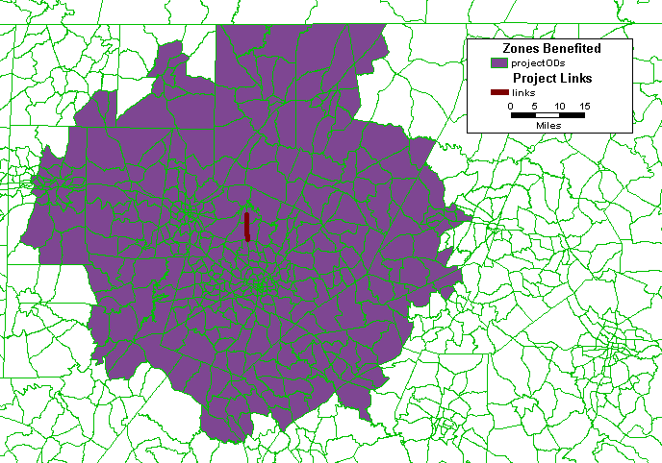
Who benefits from the project?
Project Location and Benefited Zones
Project Stats by:
  Households
  Workers
  Trips by purpose
  Trip length
  Travel time savings
  Speed increase
Notes:
These are direct users who use the project. There are also some others who benefit (indirect users) who don’t use the project
We can get a number of stats for each project:
How many households get benefited directly by the project
How many workers who live/ work in those zones get benefited
What kind of trips see the benefit (either work trip or other?)
What is the distribution of these trips?
What are the traveltime savings for each of these trips
If the project is an improvement, then how much more volume it serves or how congestiong (v/c) gets reduced or what’s the increase in speed.

Slide 17
Project Trips Summary File
Project trips by Period, Vehicle Class
Also reports dis-benefits of the projects

Slide 18
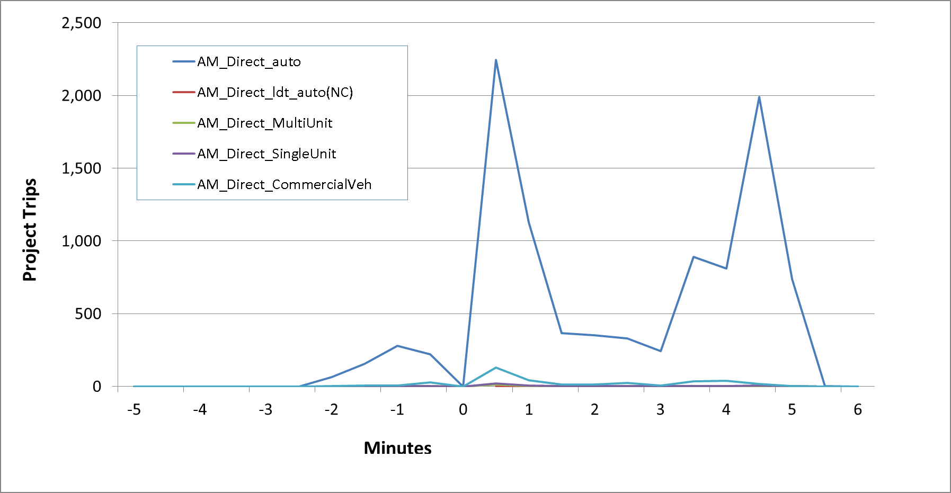
Trip Length Distribution
Quality of Project Benefit
Notes:
Quality: How project benefits? Is it a one minute savings or 10 minute savings? And how many trips / users save these minutes?

Slide 19
Conclusions
A single tool to evaluate ~1000 projects
Small Projects: Project prioritization
  Ex: Network widening, new roadways
Large Scale projects: Vision, long range
  Major network changes (upgrading all interstates in the state)
User chose on model steps and evaluation criteria
Tool to visualize the project impact, area benefited

