Slide 1

Tailor your DTA Model to Increase Forecasting Credibility, A Successful Story from Edmonton, Alberta, Canada
^{15th} TRB National Transportation Planning Application Conference
17 – 20 May 2015 Atlantic City, New Jersey,
Peter Xin, City of Edmonton
Arun Bhowmick, City of Edmonton
Ido Juran, INRO
Presented by Cherry Liu, City of Edmonton

Slide 2
Outline
Project Introduction
Pilot DTA Model Development
Model Expansion / Applications

Slide 3
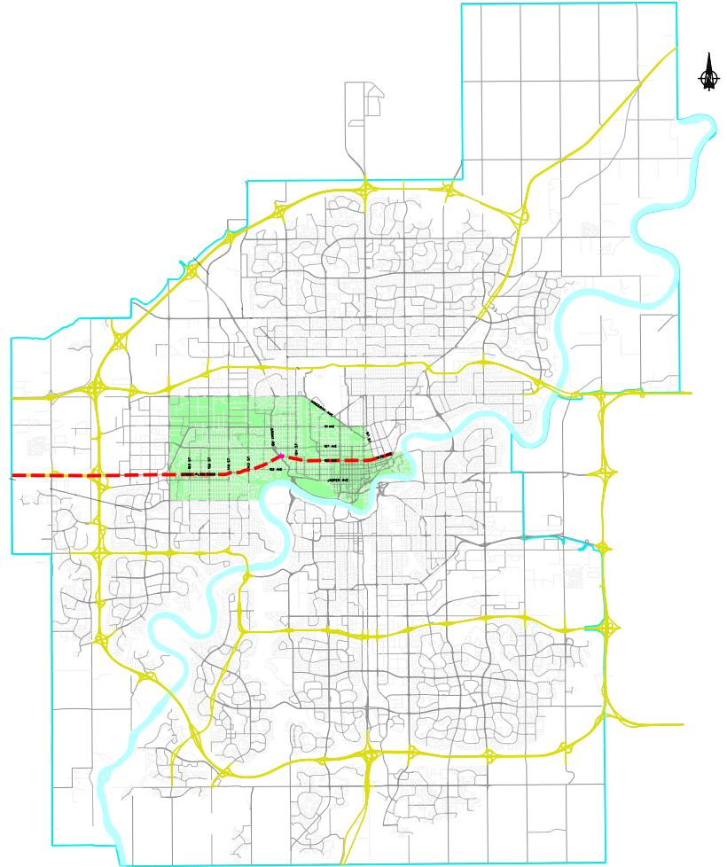
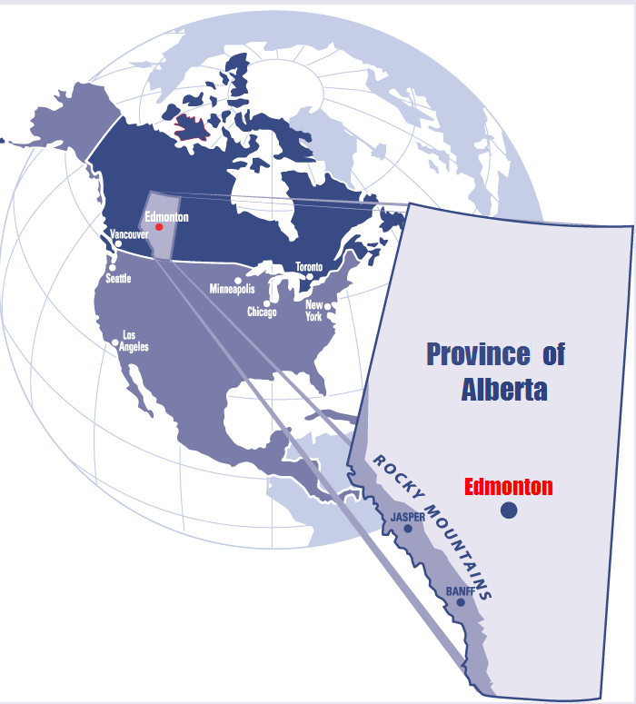
Pilot Study - Stony Plain Road Bridge Closure

Slide 4
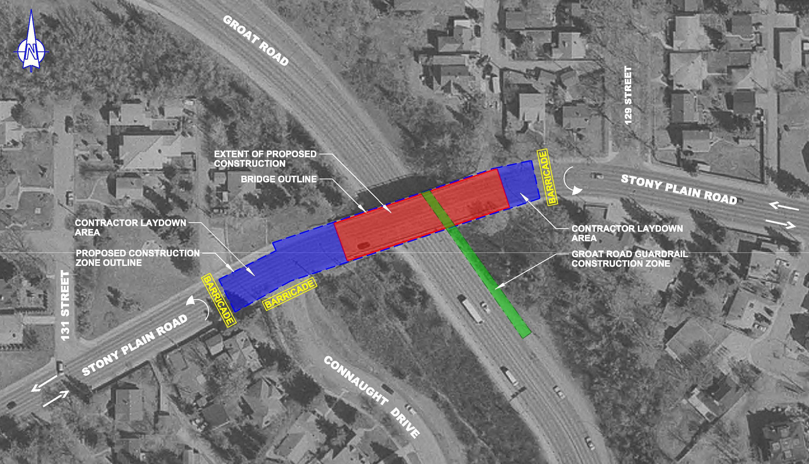
Project Location
STONY PLAIN ROAD OVER GROAT ROAD BRIDGE REHABILIATION – SITE OVERVIEW
Stony Plain Road Bridge
20,000 – 30,000 veh/day
1,800 veh/hr - WBD in PM

Slide 5
Pilot Model Development
Identify study area
Build DTA base model
Collect background information
Calibrate DTA base model (SPR Bridge Open)
Develop EMME sub area model
Validate DTA base model (SPR Bridge Closure)
Perform demand adjustment
Analyze DTA Model results

Slide 6
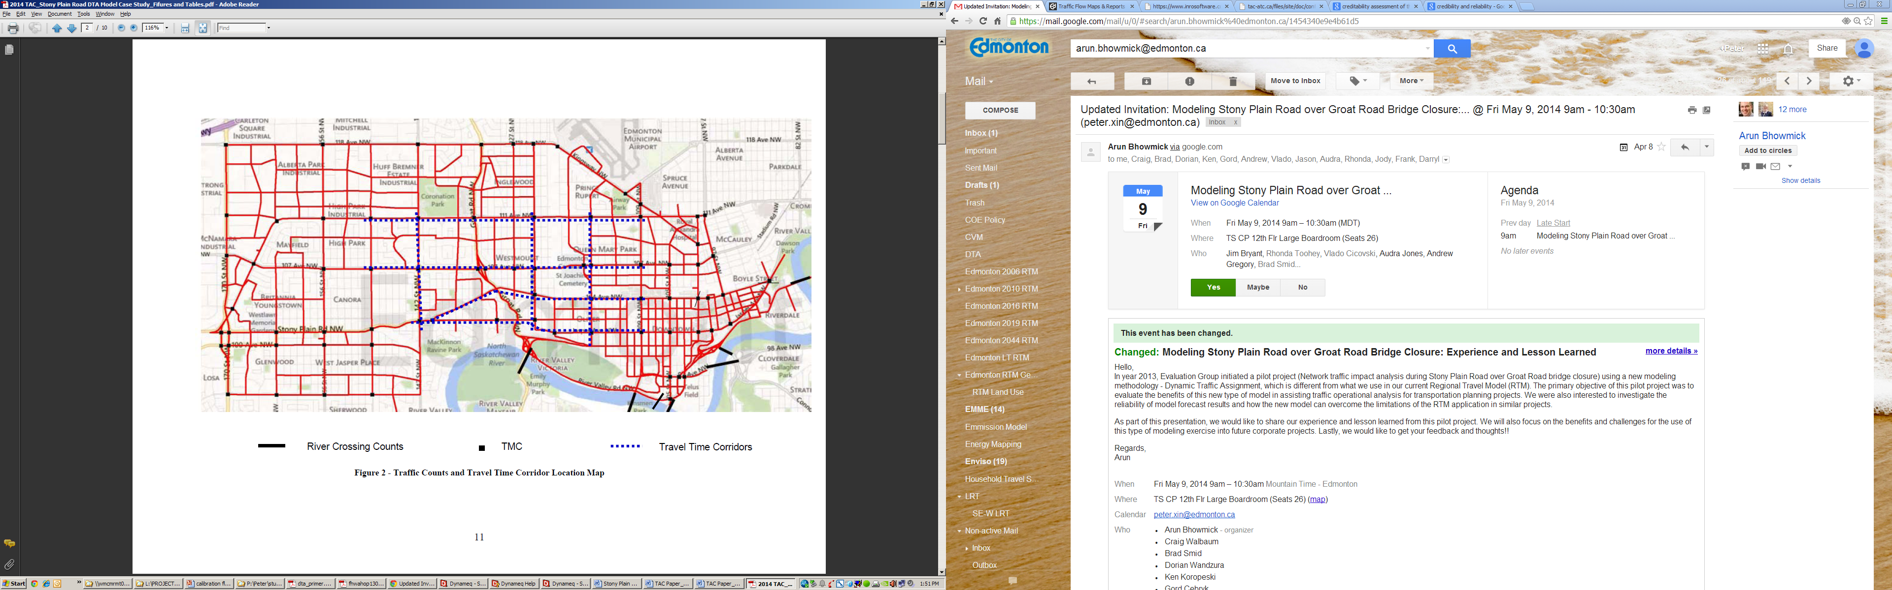
Data Collection
Traffic Demand
Network Supply
Intersection Control
Traffic Counts & Travel Times

Slide 7
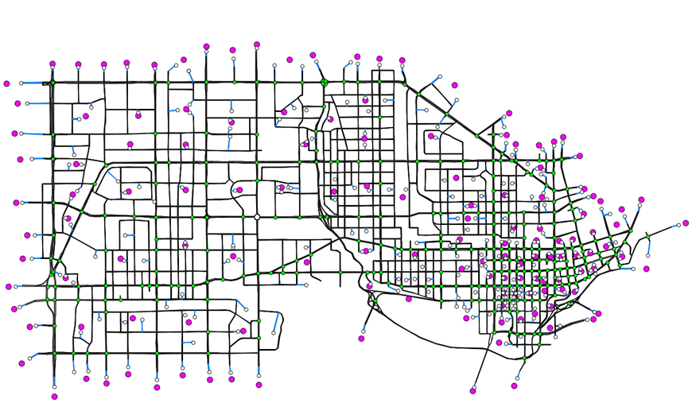
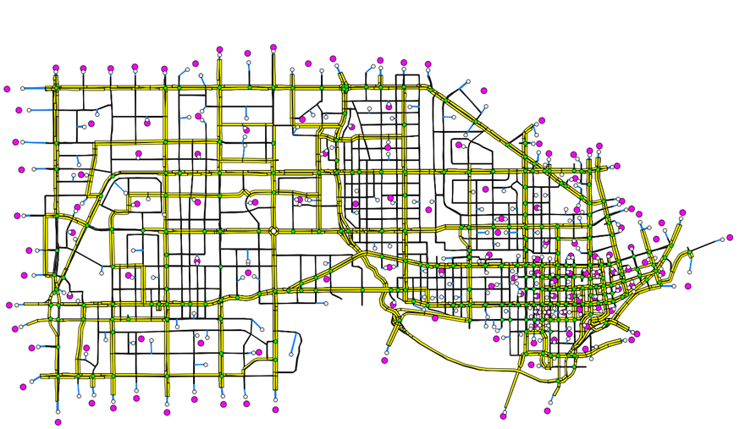
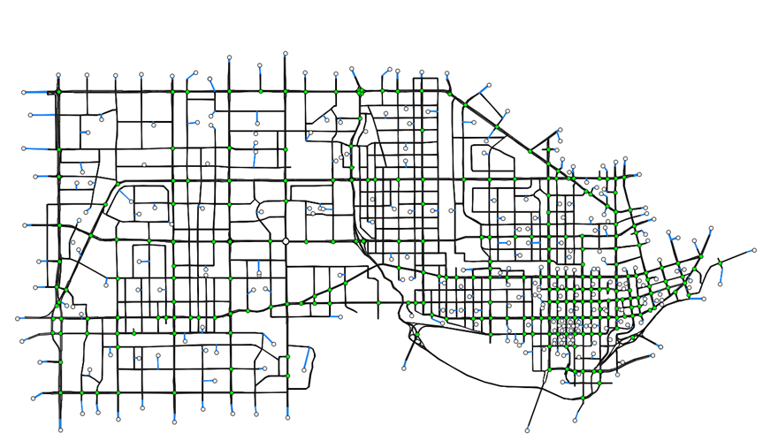
DTA Model Building
Zones: 138
Links: 4,085 Nodes: 1,624 Signals: 261
Transit Lines: 140
Auto: 77,000 veh/hr Truck: 1,900 veh/hr

Slide 8
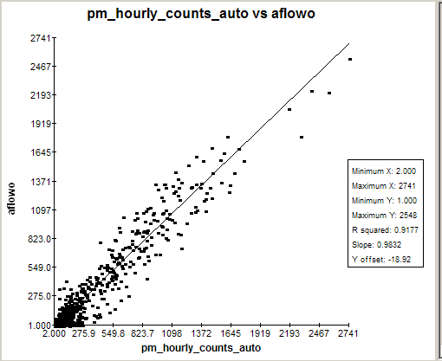
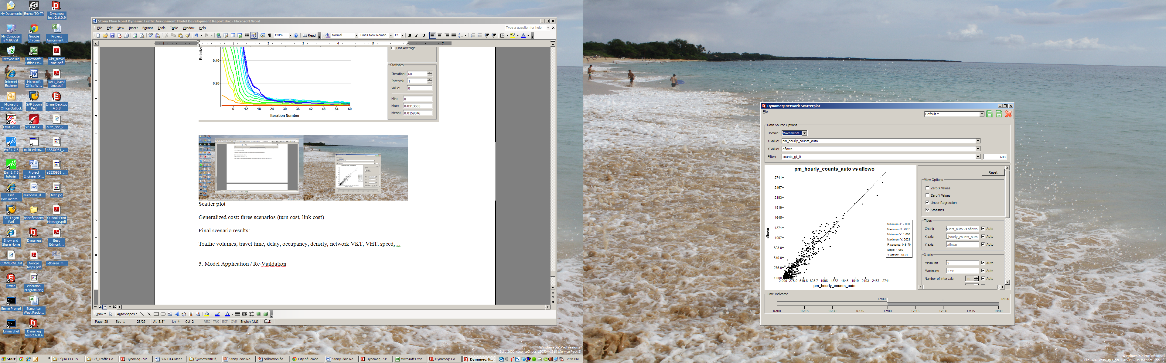
Base Model Calibration
R²=0.9177
Slope=0.9832
R²=0.9176
Slope=1.060
4:00 – 5:00 PM
5:00 – 6:00 PM
Intersection Volume Scatter Plot (Auto)

Slide 9
Corridor Travel Time Comparison (Bridge Open Scenario)
Base Model Calibration

Slide 10
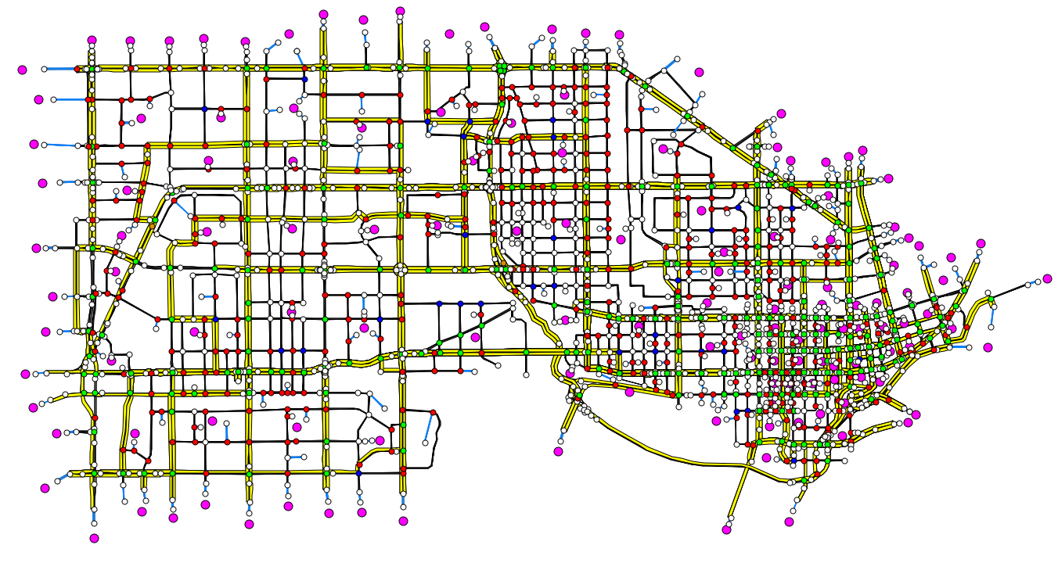
Validation - Bridge Closure

Slide 11
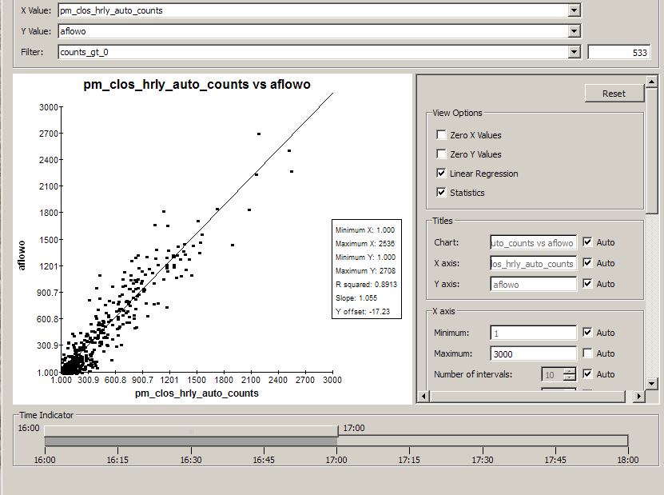
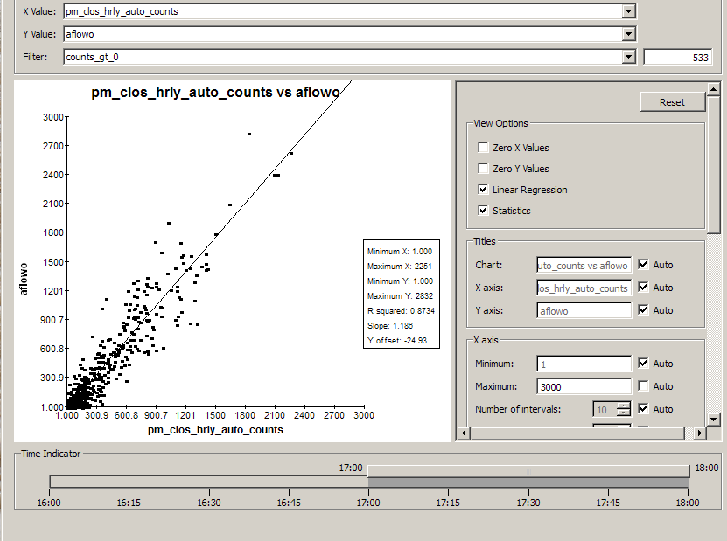
Validation Results
R²=0.8913
Slope=1.055
R²=0.8734
Slope=1.180
4:00 – 5:00 PM
5:00 – 6:00 PM
Intersection Volume Scatter Plot (Auto)

Slide 12
Validation Results
Corridor Travel Time Comparison (Bridge Closure Scenario)

Slide 13
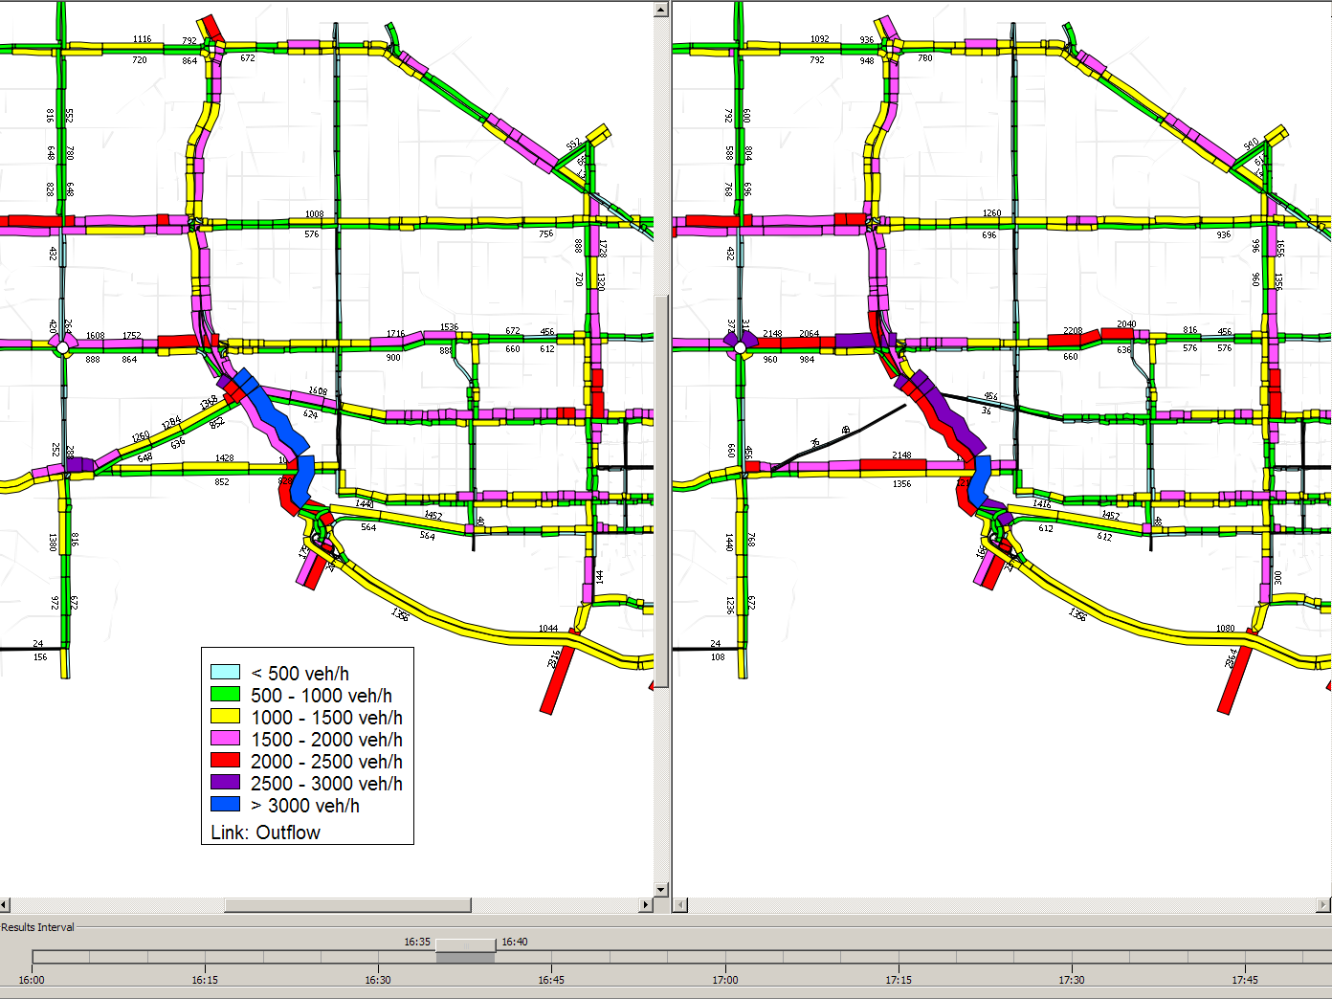
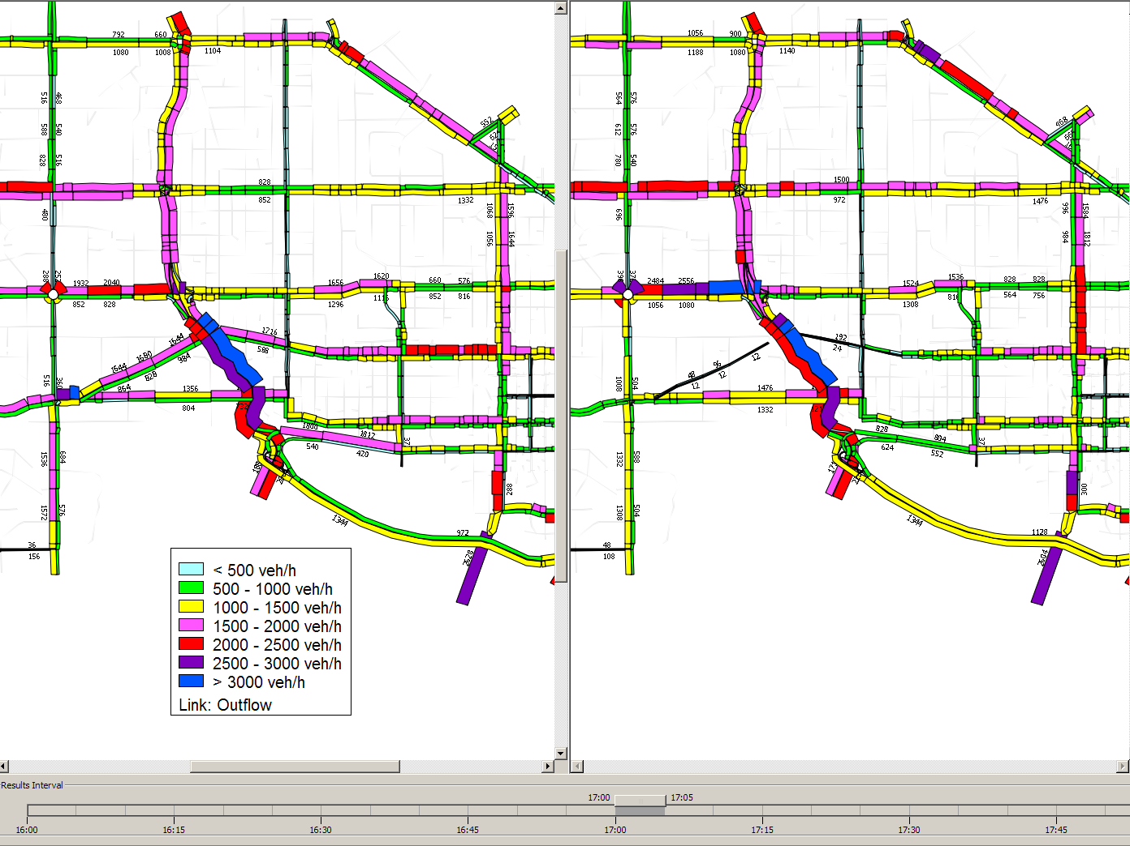
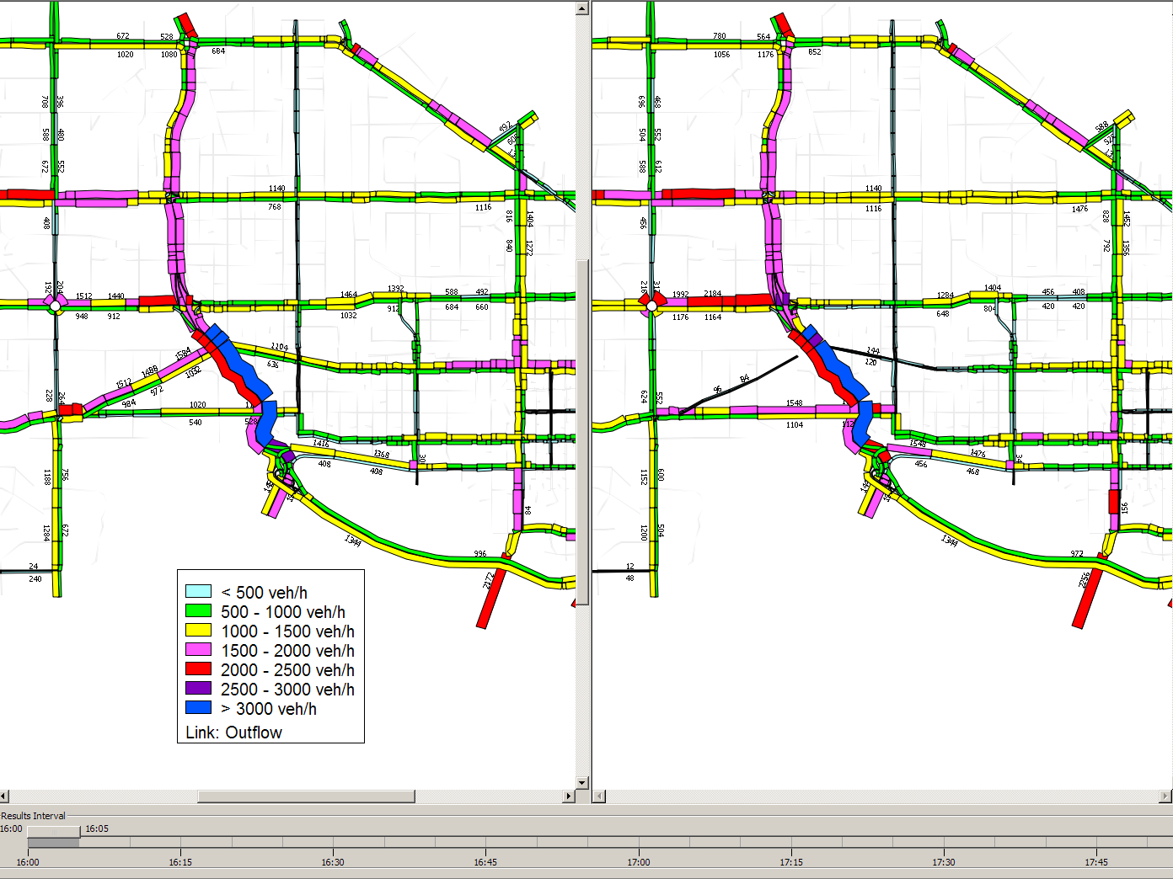
Flow Comparison
118 Ave
118 Ave
Groat Rd
Groat Rd
111 Ave
111 Ave
124 St
124 St
107 Ave
107 Ave
SPR
SPR
Jasper Ave
Jasper Ave
102 Ave
102 Ave

Slide 14
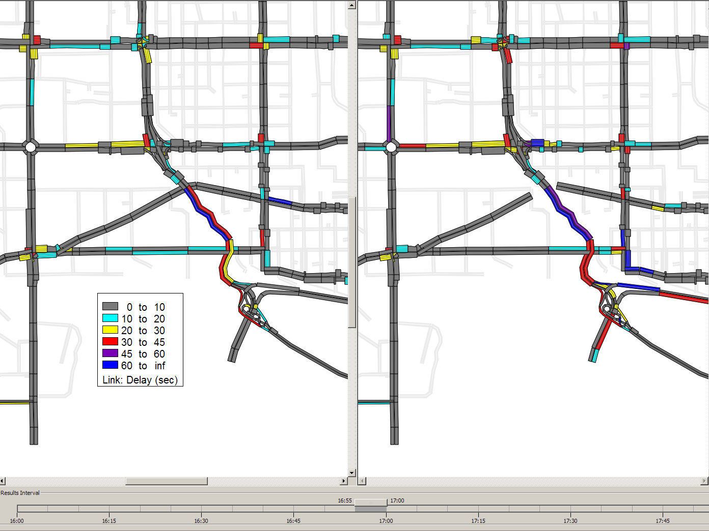
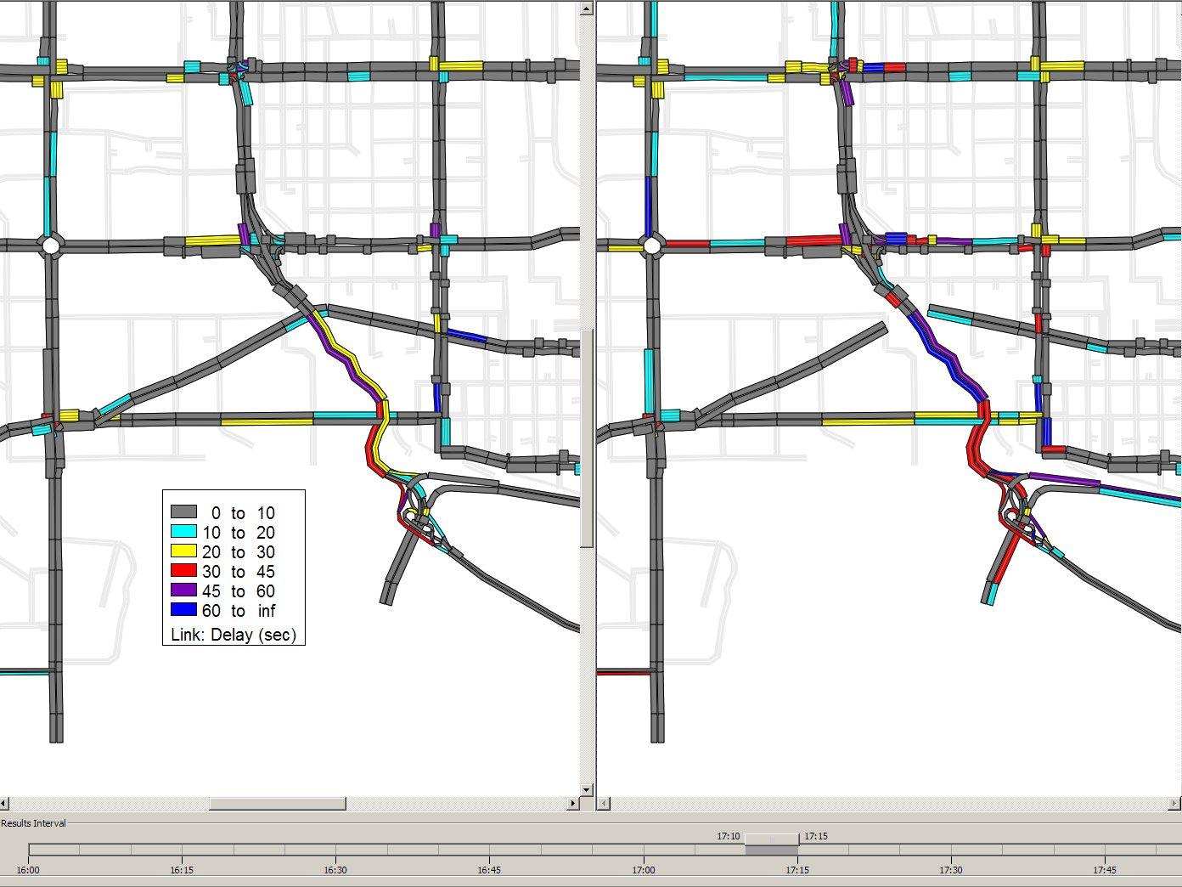
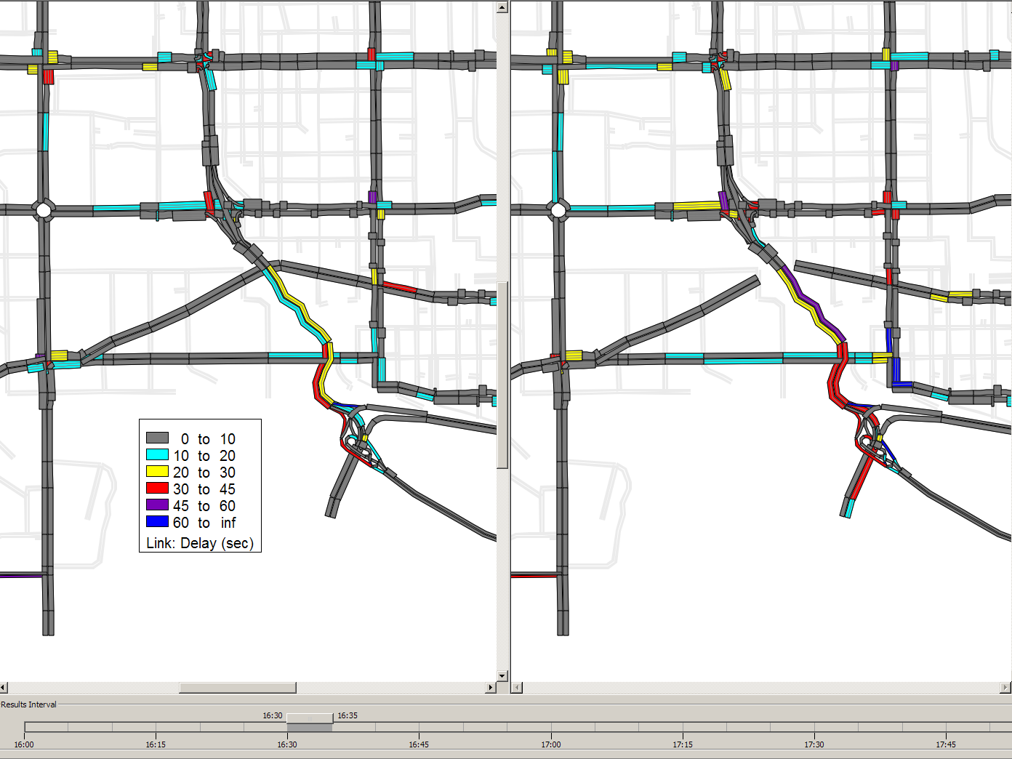
111 Ave
111 Ave
Groat Rd
Groat Rd
124 St
124 St
107 Ave
107 Ave
SPR
SPR
102 Ave
102 Ave
Jasper Ave
Jasper Ave
Delay Comparison

Slide 15
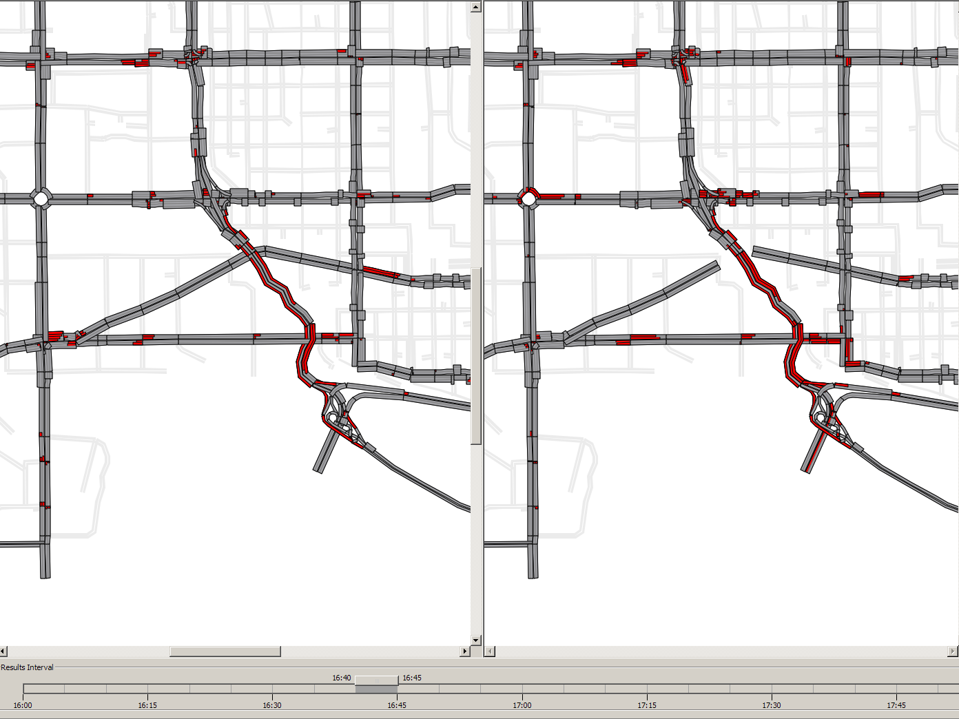
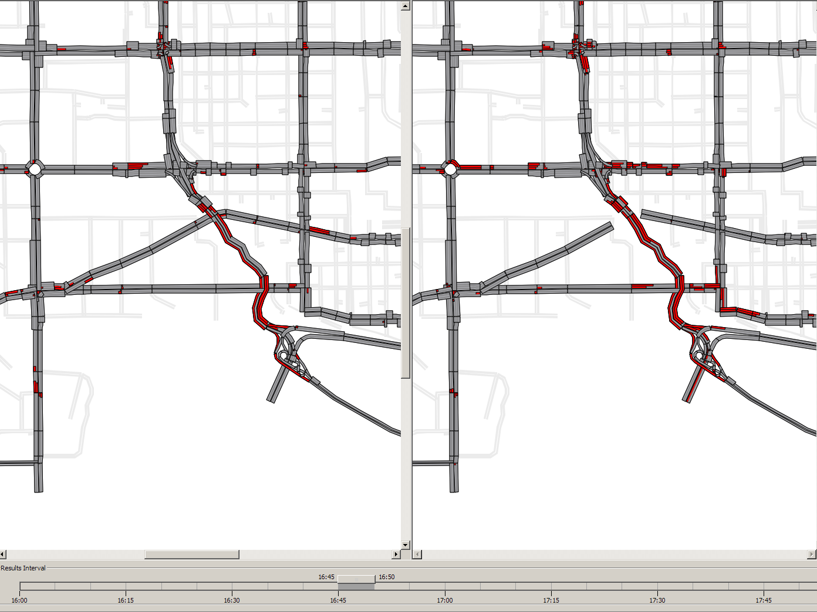

111 Ave
111 Ave
Groat Rd
124 St
Groat Rd
124 St
107 Ave
107 Ave
SPR
SPR
102 Ave
102 Ave
Jasper Ave
Jasper Ave
Queue Comparison

Slide 16
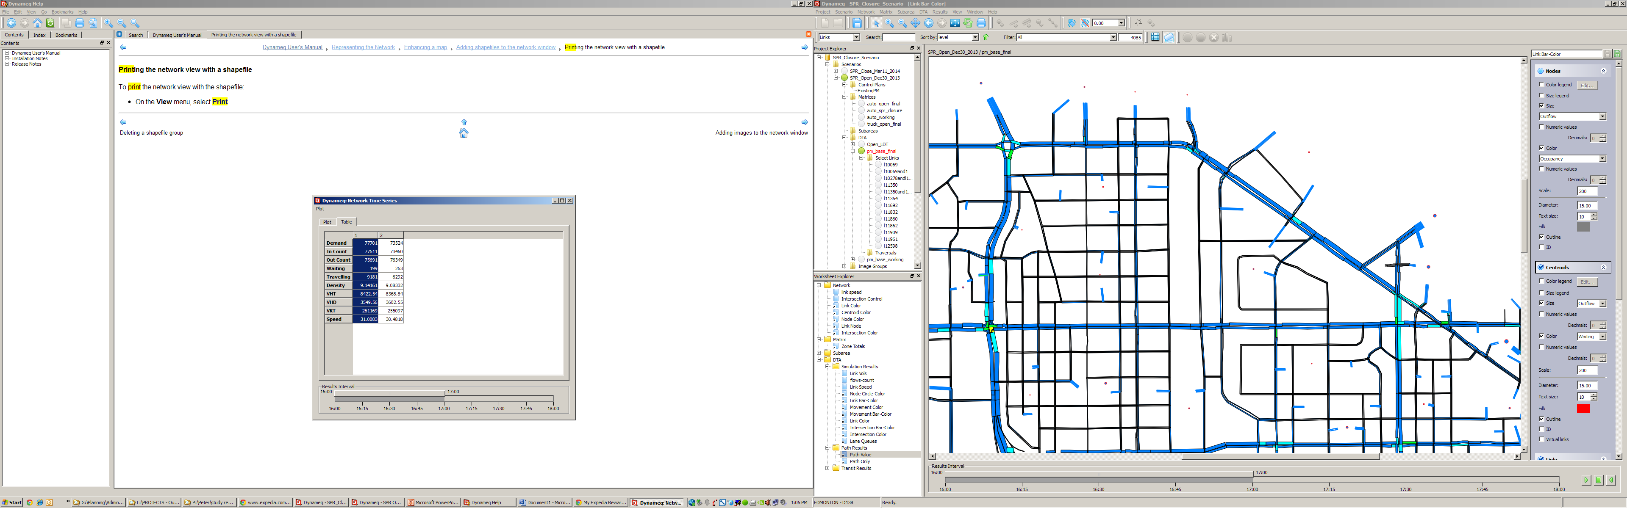
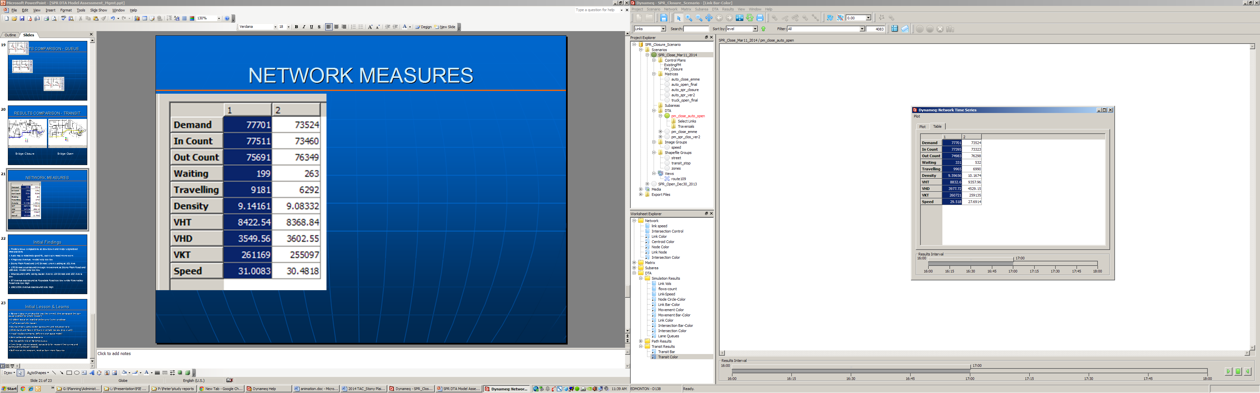
Network Measures
4:00-5:00 5:00-6:00
4:00-5:00 5:00-6:00
Bridge Open
Bridge Closure

Slide 17
Findings from Pilot Study
Spatial and temporal interactions between travelers and network
Time-dependent traffic congestion and diversion
DTA model is an effective tool for transportation planning and operational studies.
Reliable travel paths for micro simulation model input
Large amount of effort/resource required for data collection and model development
Time consistency of traffic data collection

Slide 18
Downtown Accessibility Study
To develop strategies to manage downtown accessibility due to the construction of major infrastructure and development projects over next few years (2015-2020).
Number of scenarios will be tested to evaluate expected traffic impact and to identify associated mitigation measures.
    102 Avenue /Connors Road Closure - Valley Line LRT
    104 Avenue Arena / Entertainment District
    Jasper Avenue New Vision
    Downtown bypass Commuter Route

Slide 19
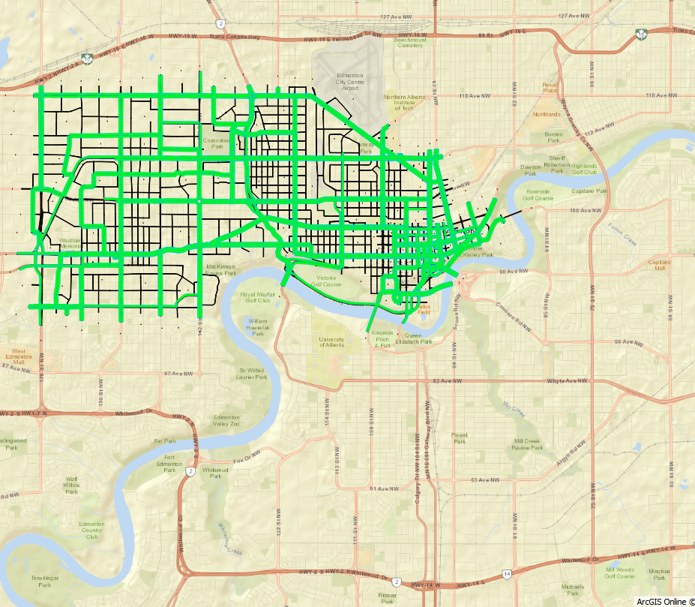
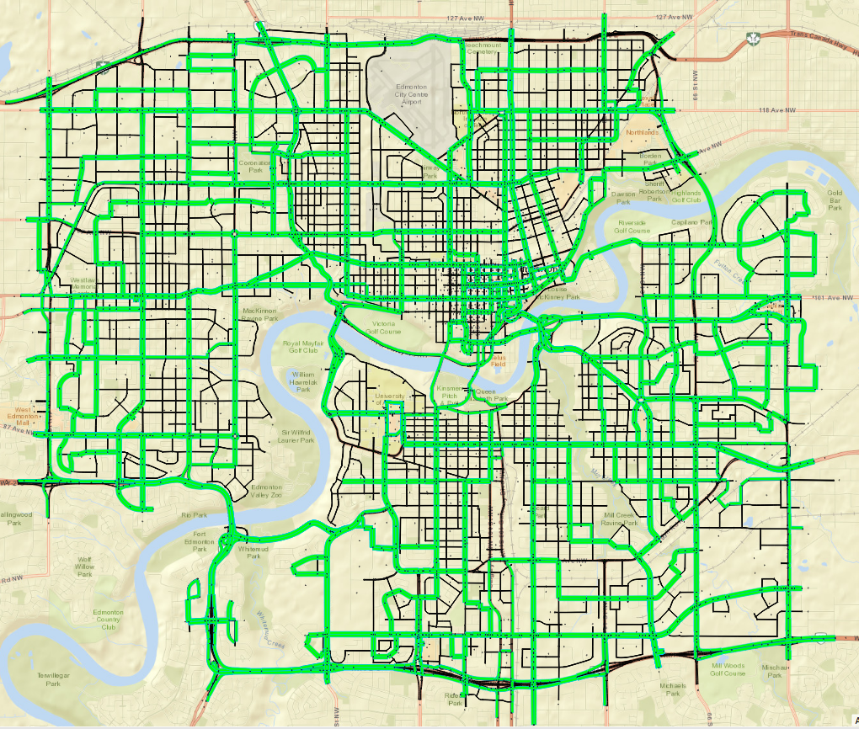
Downtown DTA Study Area
Links: 4,085 / 11,413
Nodes: 1,624 / 4,509
Signals: 261 / 548
Zones: 138 / 293
Transit Lines: 140 / 201
Auto: 77k veh/hr / 147k
Truck: 1.9k veh/hr / 4.3k
Employment:
150k / 275k (55%)
Population:
130k / 266k (32%)

Slide 20
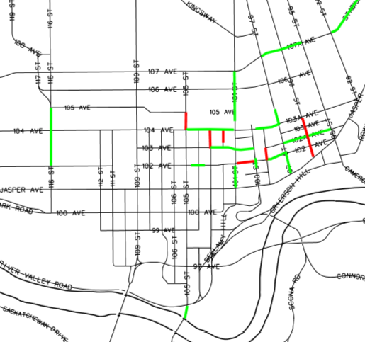
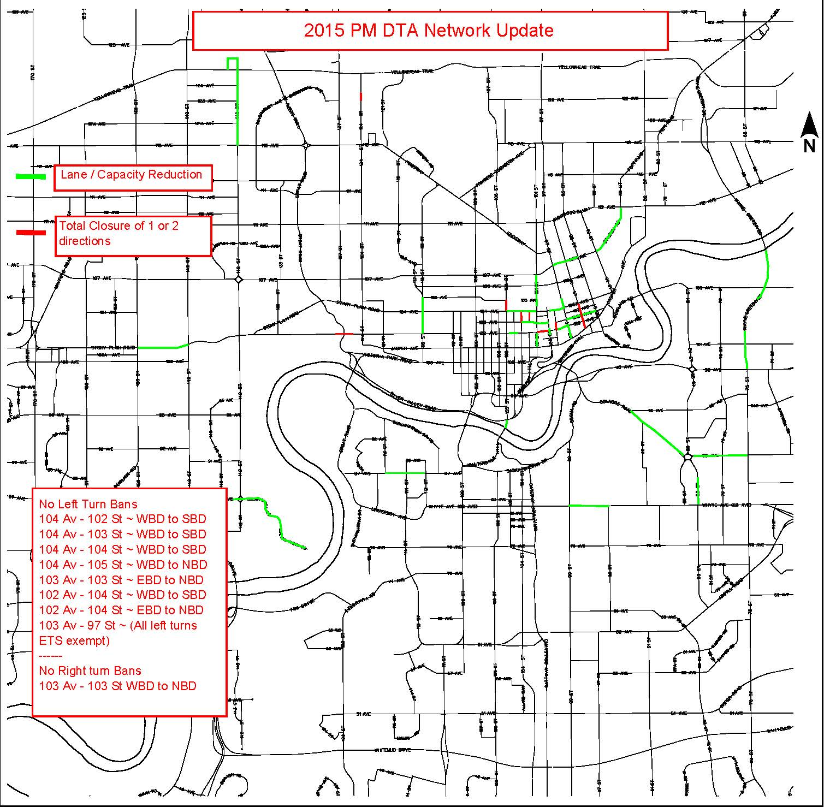
Downtown DTA Network Update
Lane Reduction / Closure
Turn Bans
Parking Bans

Slide 21
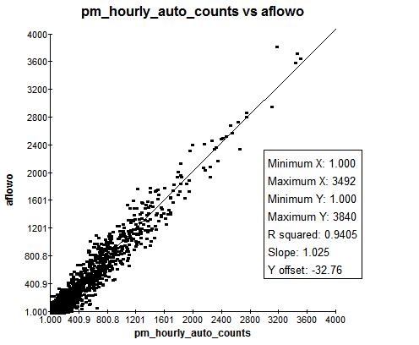
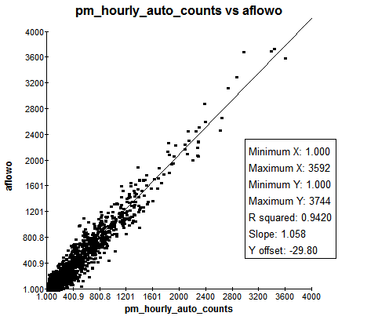
Model Calibration
R²=0.9405
Slope=1.025
R²=0.9420
Slope=1.058
4:00 – 5:00 PM
5:00 – 6:00 PM
Intersection Volume Scatter Plot (Auto)

Slide 22
Model Calibration
Corridors Travel Time Comparison

Slide 23
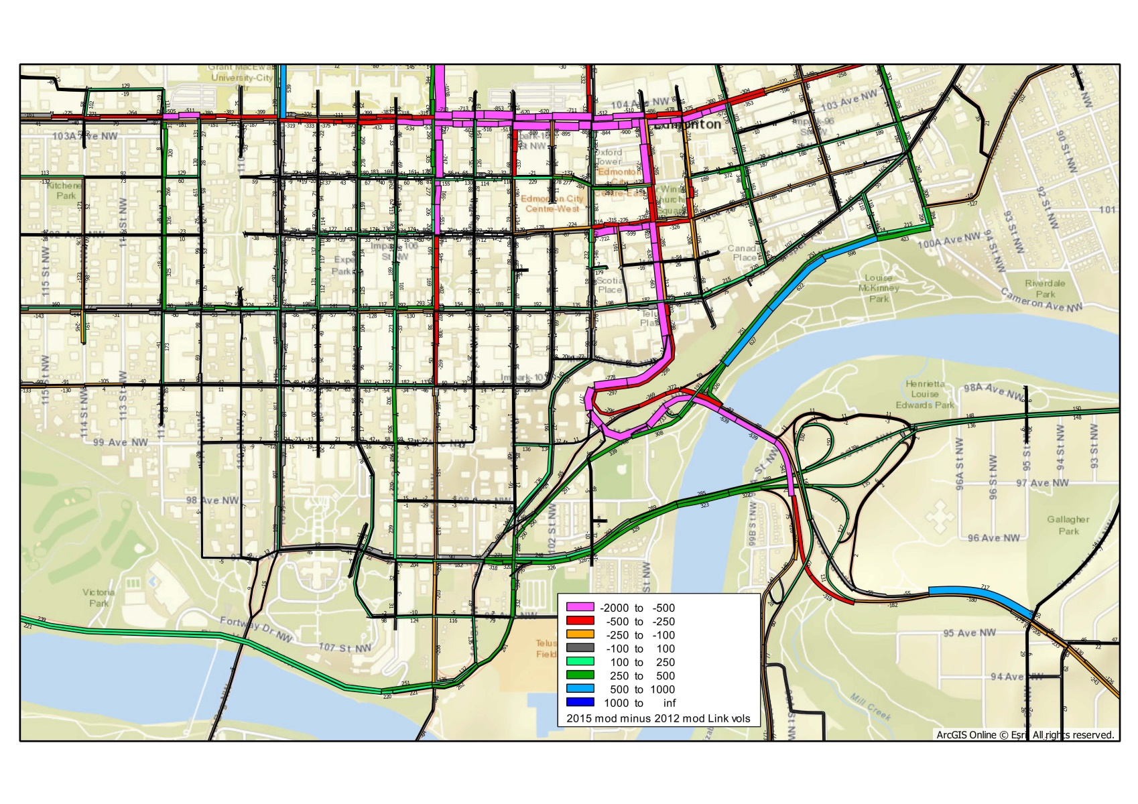
Link Flow Comparison

Slide 24
A Succesful Story
Model Result is credible
More Projects to Come
Benefit Transportation Planning

Slide 25
Questions?
peter.xin@edmonton.ca
cherry.liu@edmonton.ca

Slide 26
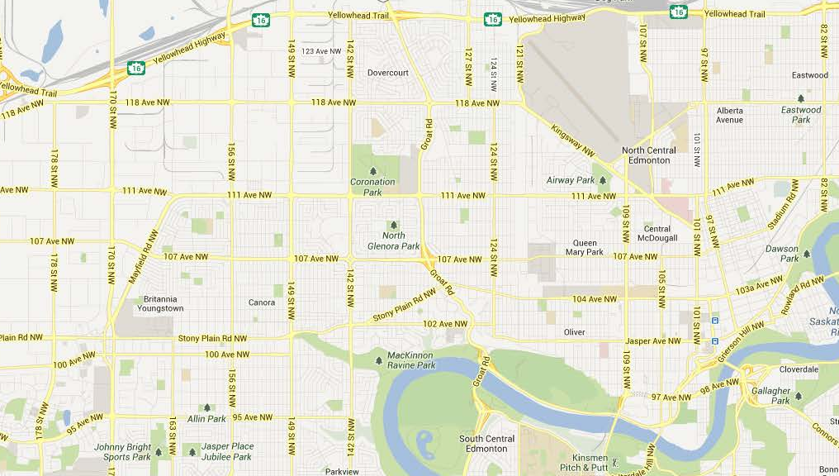
Study Area

Slide 27
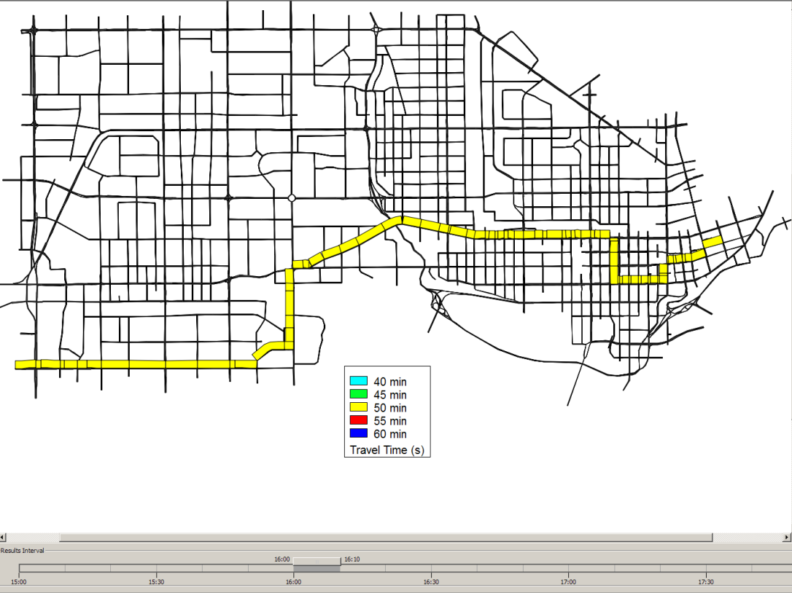
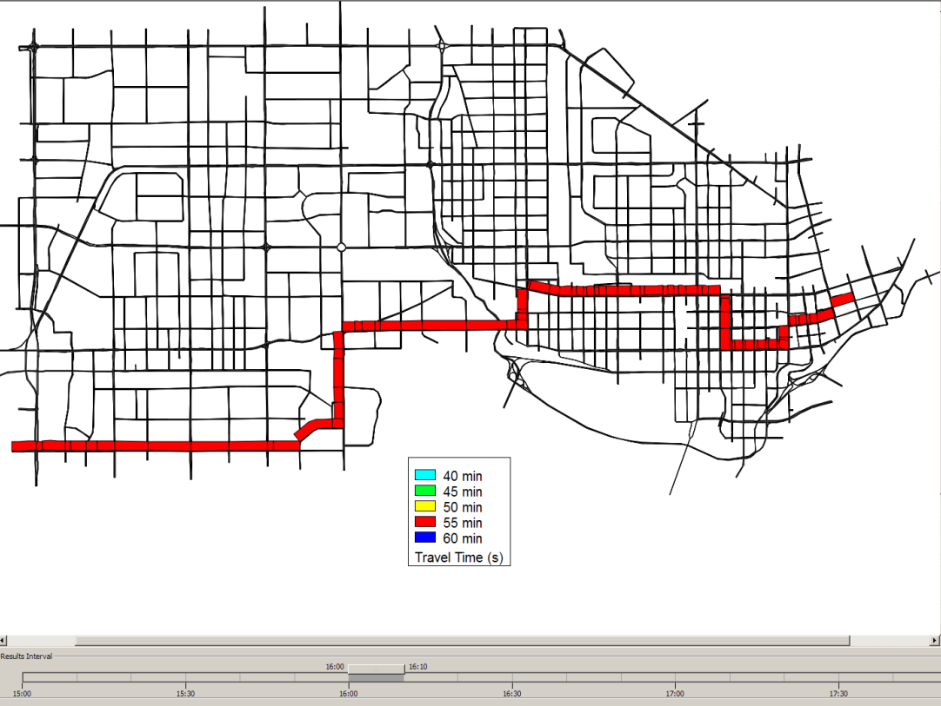
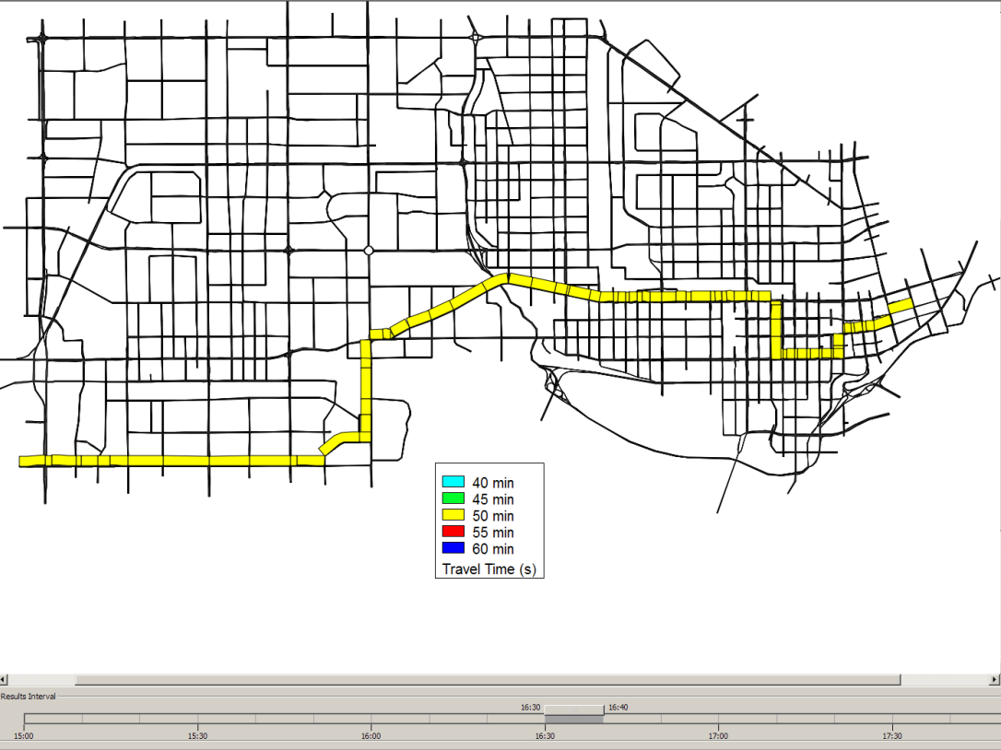
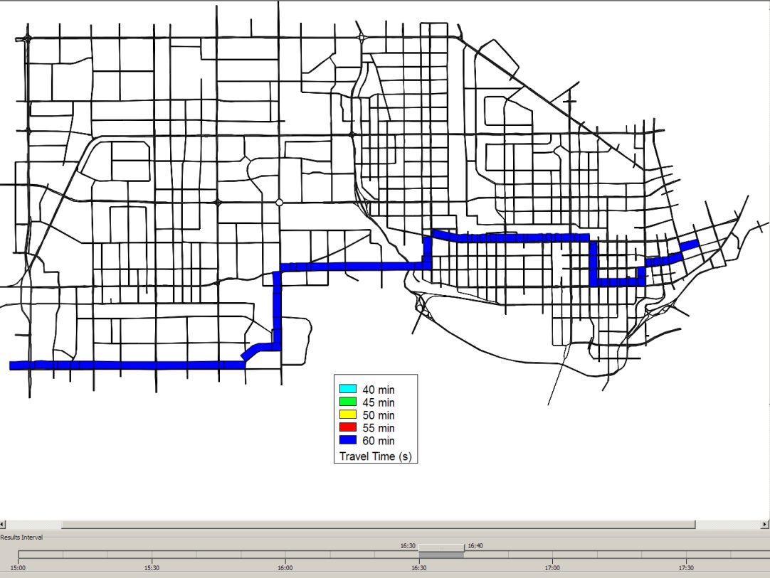
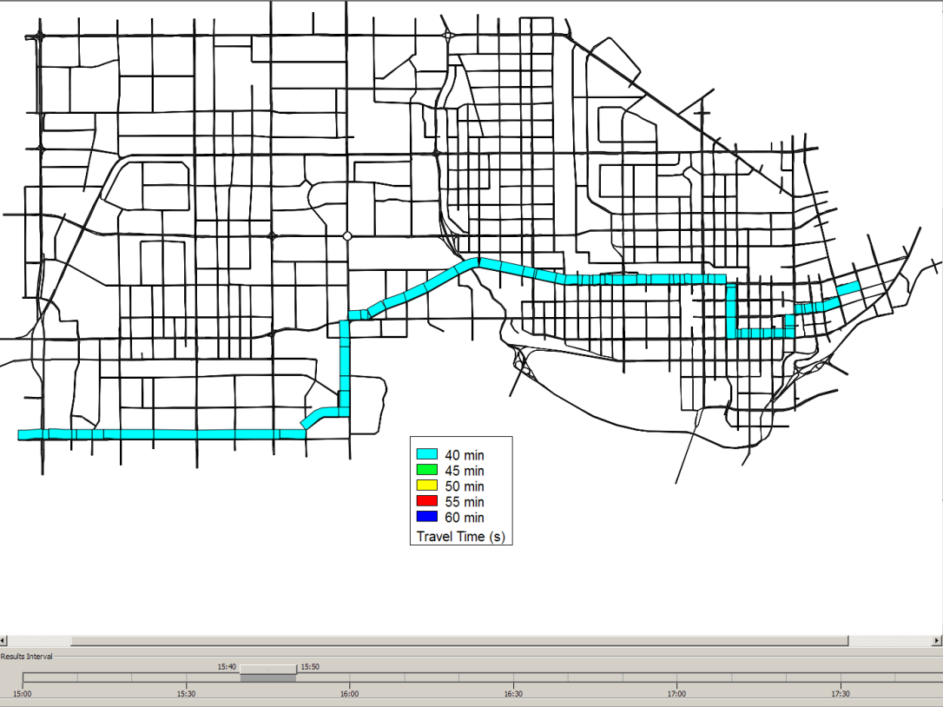
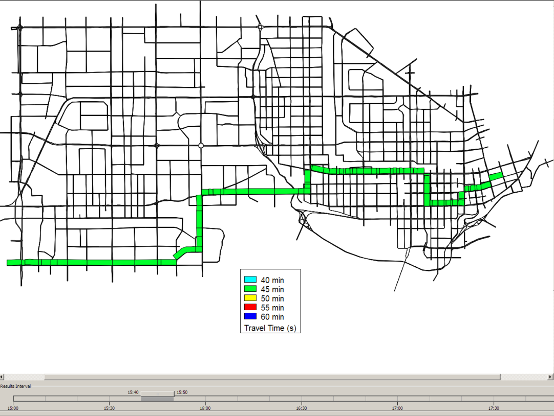
Bridge Open
Bridge Closure
Transit Travel Time Comparison

