Slide 1

Outline
Prepared for TRB application conference 2015
Dynamic OD Demand Estimation based
on Observed Sensor Data
Jiangtao Liu, Arizona State University
Xuesong Zhou, Arizona State University

Slide 2
Outline
Outline
Introduction to dynamic OD demand estimation
Methodology in our model
Numerical experiments
Existing challenges

Slide 3
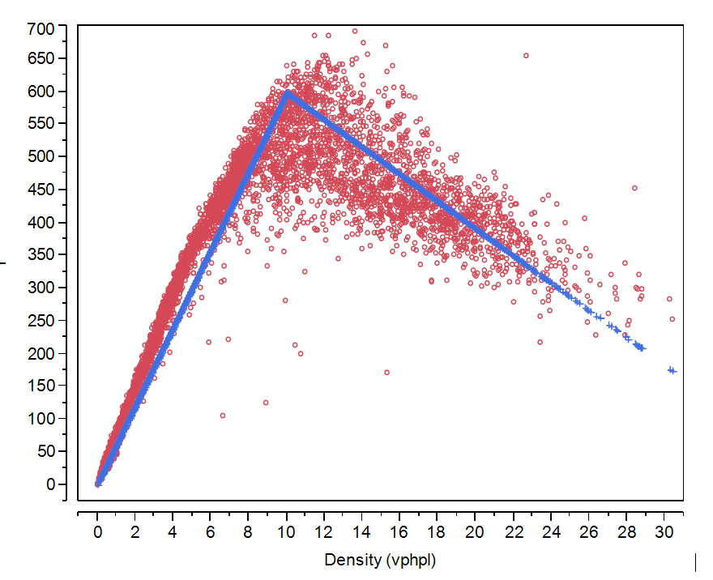
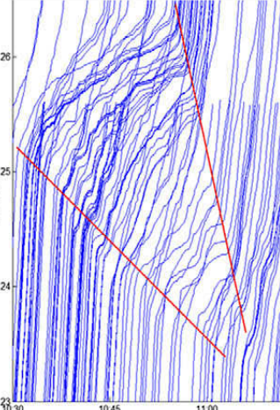
1. Introduction
Dynamic OD demand: spatial and temporal trip distribution
  Static OD Demand
  Time-dependent profile
Traffic network: capacity, speed limit, jam density, backward wave speed
Observed flow and density data
Vehicle trajectory(Herrera et al. 2010)

Slide 4
1. Introduction
Dynamic Traffic Assignment

Slide 5
1. Introduction
Dynamic OD Demand Estimation

Slide 6
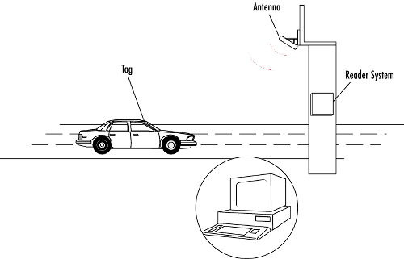


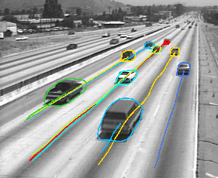
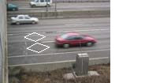
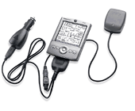
1. Introduction
Observed Traffic Data:
  Link Flow/Count: loop detectors
  Link Density: Video Image, or converted from speed data
  Speed Data (Link travel time): probe cars, detectors.
Semi-continuous
path trajectory
Continuous
path trajectory
Point
Point-to-point
Loop Detector
Automatic Vehicle Identification
Automatic Vehicle Location
Video Image Processing

Slide 7
1. Introduction
Link Flow/Count Data:
Link Speed Data: (1) estimate the traffic state; (2) easier to be observed than link density.

Slide 8
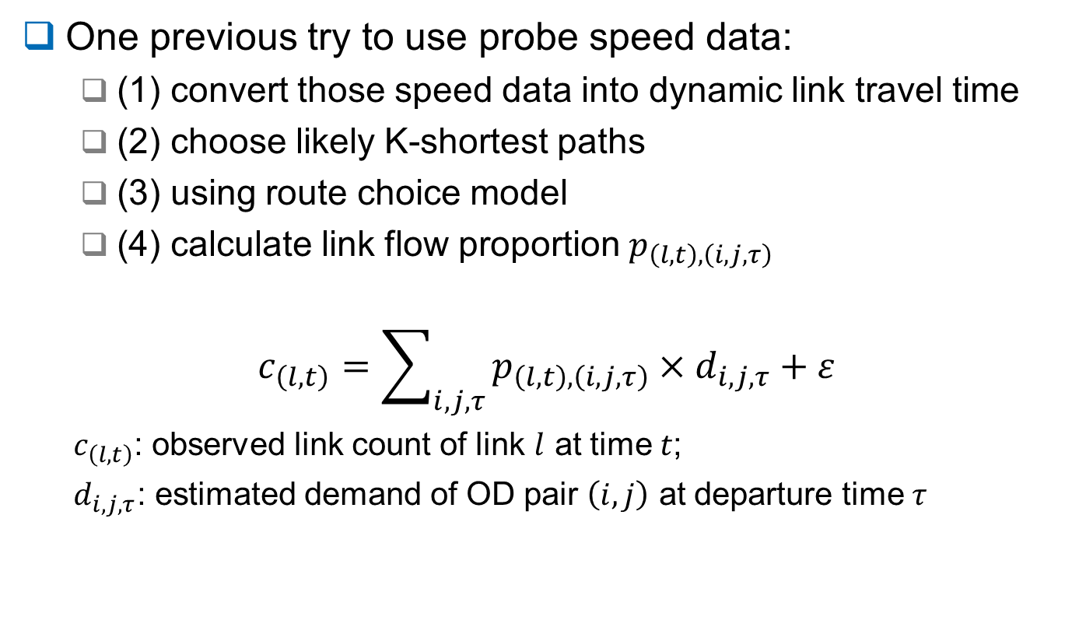
1. Introduction
One previous try to use probe speed data:
  (1) convert those speed data into dynamic link travel time
  (2) choose likely K-shortest paths
  (3) using route choice model
  (4) calculate link flow proportion $p_{\left(l,t\right),\left(i,j,τ\right)}$
$$c_{\left(l,t\right)}=\sum_{i,j,τ}{p_{\left(l,t\right),\left(i,j,τ\right)}×d_{i,j,τ}+ε}$$
  $c_{\left(l,t\right)}$: observed link count of link $l$ at time $t$;
  $d_{i,j,τ}$: estimated demand of OD pair $\left(i,j\right)$ at departure time $τ$

Slide 9
1. Introduction
One previous try to use probe speed data:
  Travel time of path 1 is equal to travel time of path 2
4
lanes
(
50
%)
4
lanes
(
80
%)
Path
1
Path
1
Path
2
Path
2
1
lane
(
50
%)
1
lane
(
20
%)
Without capacity constraints
With capacity constraints

Slide 10
2. Methodology in our model
Single-level path flow-based optimization model
Objective function:
  (1) minimize the deviation between estimated OD demand and historical OD demand;
  (2) minimize the deviation between estimated and observed traffic states (link flow/count, density, travel time)
Constraints:
  (1) Dynamic Network Loading of path flows based on Newell’s Kinematic Wave model (Newell, 1993)
  (2) Gap function-based dynamic user equilibrium conditions.
Algorithms: Lagrangian Relaxation

Slide 11
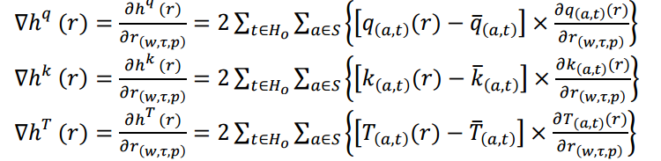
2. Methodology in our model
Partial derivatives(link flow, density, travel time) of path flow adjustment:
The gradients of path flow:
Link flow/count
Link density
Link travel time

Slide 12
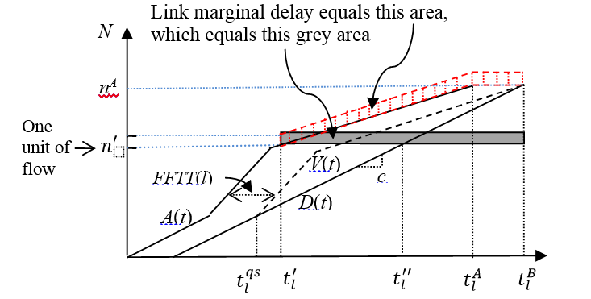
2. Methodology in our model
Partial derivatives(link flow, density, travel time) of path flow adjustment:
  Individual link: free-flow, partially congested, fully congested;
  Two sequential links: queue spills back or not
(Ghali and Smith, 1995)

Slide 13
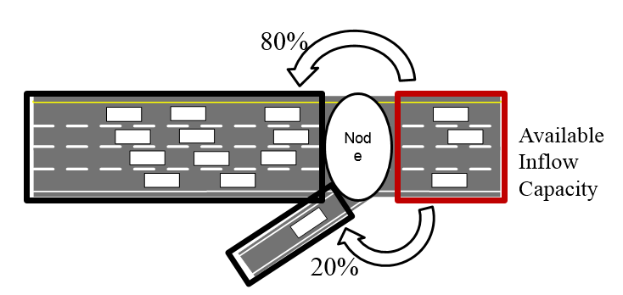
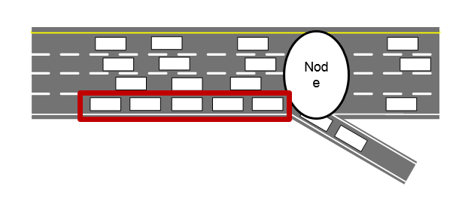
2. Methodology in our model
The calculation on link partial derivatives is still an approximation method.
Merging junction
Diverging junction

Slide 14
3. Numerical experiments
Illustration in a static case:
Link cost function:
T_{a} = FFTT_{a} (1+ r_{a} / cap_{a})
Path | FFTT (min) | Capacity (veh/hr) | Assigned Flow (veh/hr) | Travel Time (min)
Path 1 | 20 | 3000 | 5400 | 56
Path 2 | 30 | 3000 | 2600 | 56

Slide 15
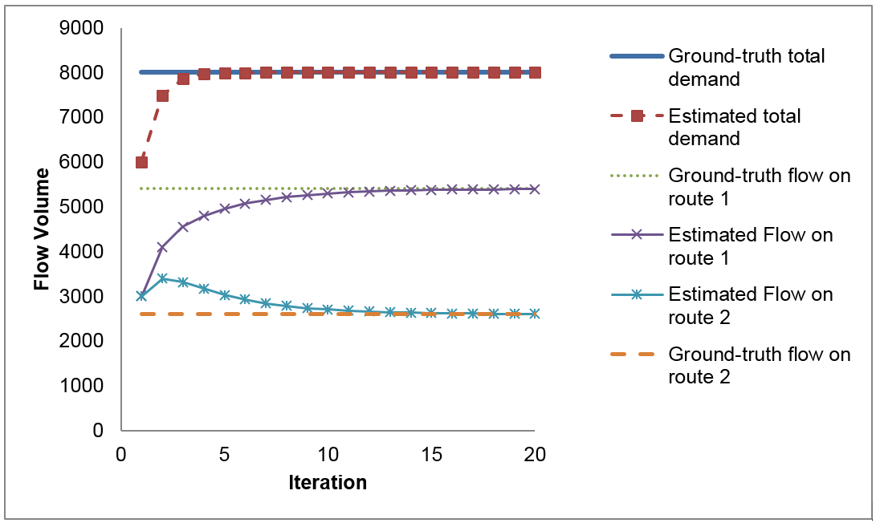
3. Numerical experiments
Illustration in a static case:

Slide 16
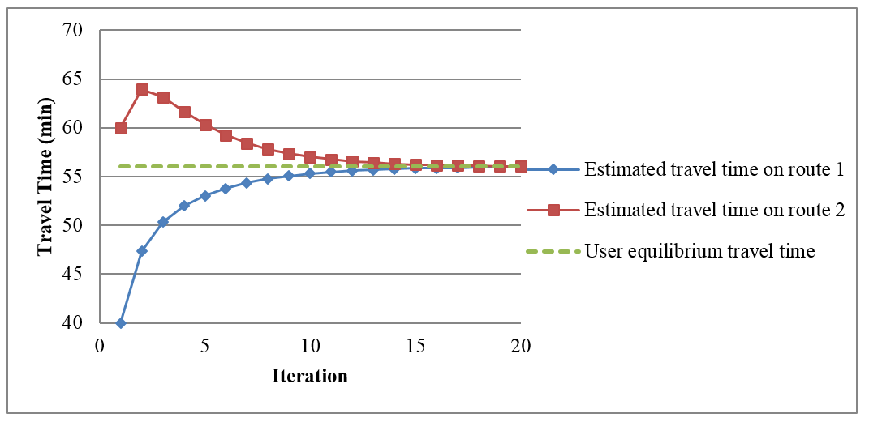
3. Numerical experiments
Illustration in a static case:

Slide 17
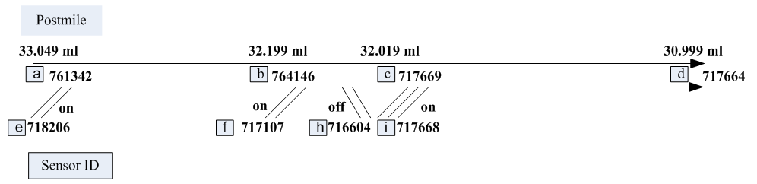
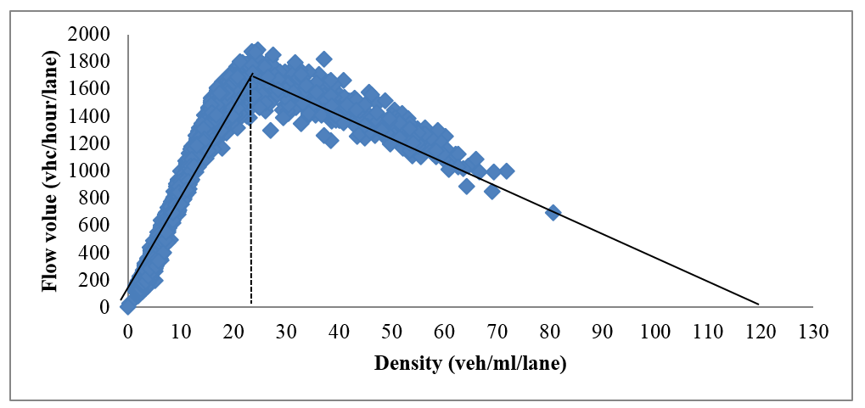
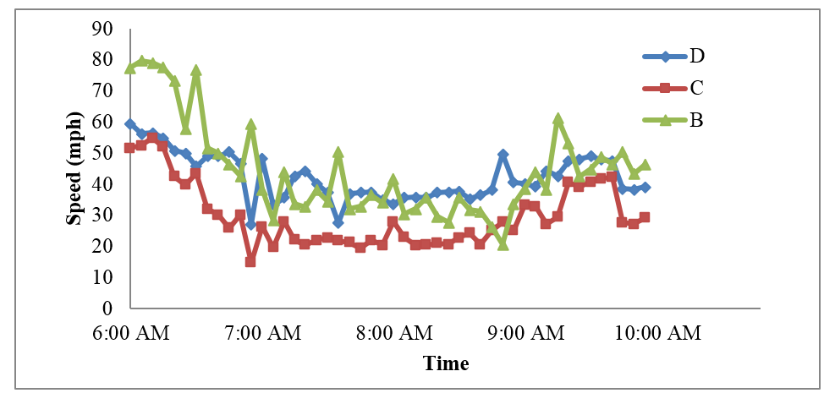
3. Numerical experiments
Network representation of a section of I-210 West bound corridor in LA

Slide 18
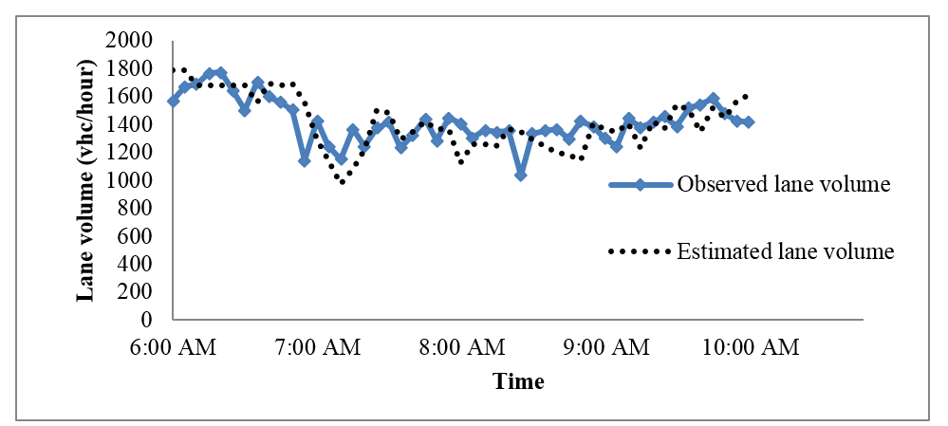
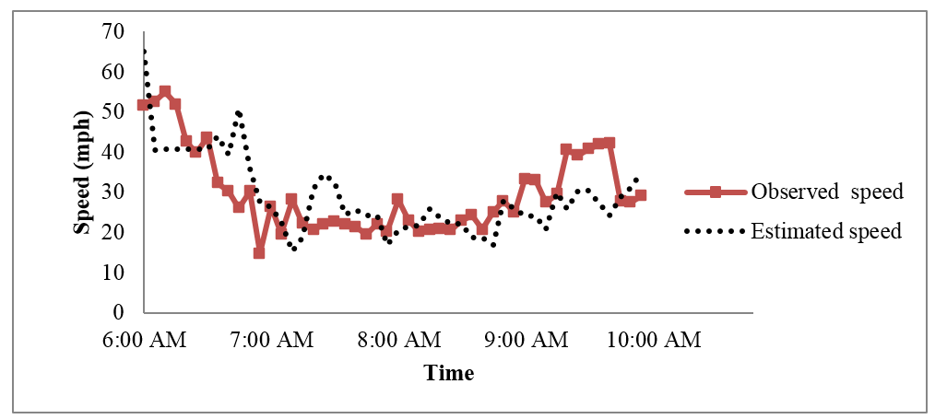
3. Numerical experiments
Observed & estimated lane volume on station a link
Observed & estimated speed on station c link

Slide 19
4. Challenges
Traffic network building: link capacity, speed limit, jam density, backward wave speed;
Historical dynamic OD demand: a good time-dependent profile for static OD demand
Observed data consistency: data quality control; cluster analysis
Travel behavior: dynamic user equilibrium, bounded rationality, road type preferences, and so on.
Algorithm: path partial derivative

Slide 20
Thanks!

